Slide 1
Global Educational issues
Integration of Class Reflections

Slide 2
What goal? Where to put resources?
Learning Outcomes
Facitities
Teachers
Attendance

Slide 3
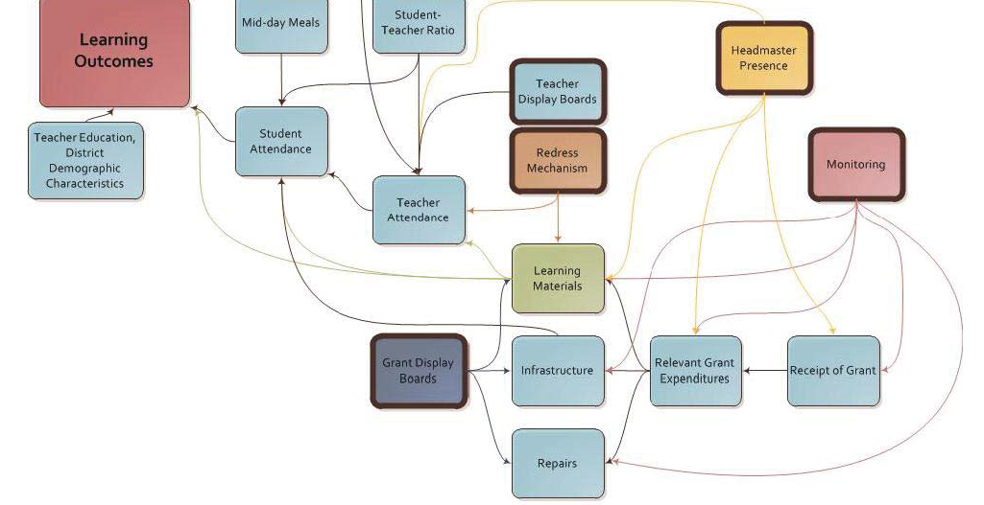
Indian Success Factors
From Lessons in Learning: An Analysis of Outcomes in India’s Implementation of the Right to Education Act, Harvard, 2013

Slide 4
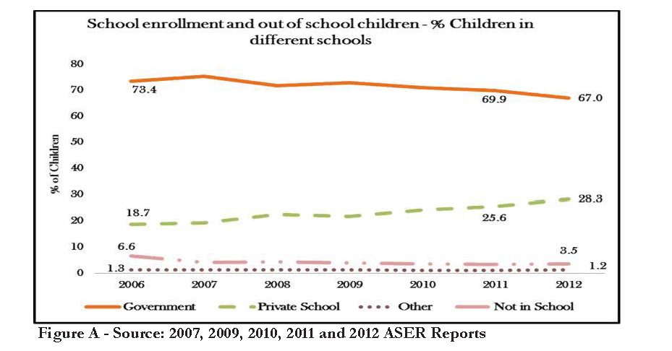
Increasing Private Schools

Slide 5
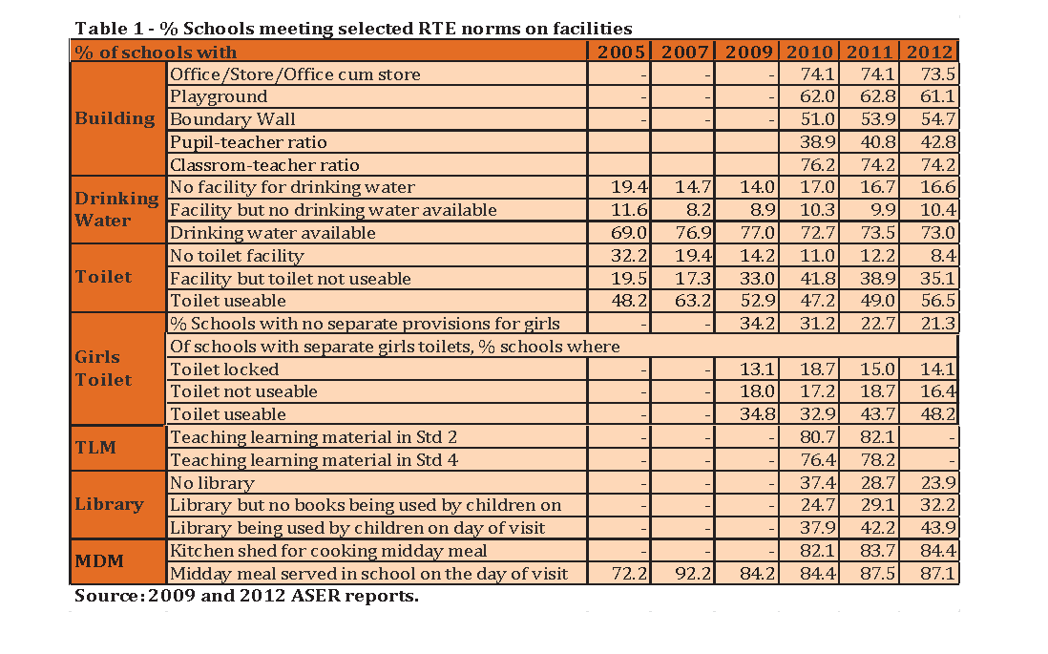
Improving Facilities

Slide 6
Vulnerable Children: Early childhood development determines outcomes
Early Childhood
Health care
Preschool
Safe environments
Elementary
Basic literacy/numeracy
High School
Parental Involvement
Nutrition
nurture
Parents who can parent
Special needs care
Vocational Orientation
Social inclusion
Accessiblity
Toilets
Sustaining Safe Environments
Accessible Resources
Lifelong Learners
Training Teachers
Social Transformation
Heidi Rico
Vargas-Barron (2005)
UNICEP (2012)

Slide 7
The Reasons for Vocational Training
The love for learning and employment is critical for youth to develop as marketable professionals and social contributors.
“Skills are vital for poverty reduction, economic recovery and sustainable development”(UNESCO,2009).
Youth, male and female alike must be exposed at an early age to different careers and given the vision for a future where they can contribute.
This vision must be shared with parents and communities as well.
in order for the skills and training to be relevant to changing economic and social structures of society. (Omar’s summary of UNESCO)
Is this the aim of education?

Slide 8
Education as Moral Formation, Societal Engagement
Next, there must be an emphasis on the type of education children receive. A holistic education that includes in particular social and moral development will best benefit the children and society at large. This can be best accomplished through church-community partnerships in the selection and implementation of school curricula. Finally, there must be an emphasis on ensuring a high quality of education. (GiveWell, 2009).
Doug’s summary

Slide 9
References
UIS. (2006). Participation in Formal Technical and Vocational Education and Training Programmes Worldwide. Bonn, Germany: UNESCO-UNEVOC.
UNESCO. (2007). Another Way to Learn: Case Studies. France: UNESCO.
UNICEF. (2012). State of the World’s Children 2012. New York: UNICEF.
Vargas-Baron, E. (2005). Planning Policies for Early Childhood Development. UNESCO
Harvard School of International Affairs (2013). Lessons in Learning: An Analysis of Outcomes in India’s Implementation of the Right to Education Act.
ell: Real Change for you dollar. (2009). Retrieved from Developing-world education (in-depth review): http://www.givewell.org/international/education#Anoteonthispagespublicationdate
Joseph, P. G. (2005). Issues in Basic Education in Developing Countries: An Exploration of Policy Options for Improved Delivery. Journal of International Cooperation in Education, 129-152.
UNESCO. (2009). Retrieved from Technical and Vocational Education and Training (TVET): http://www.unesco.org/new/en/education/themes/education-building-blocks/technical-vocational-education-and-training-tvet/

