Slide 1
Biblical Basis for Vocational Training
Amanda Sanchez, Ph.D.
CaCHE Global

Slide 2
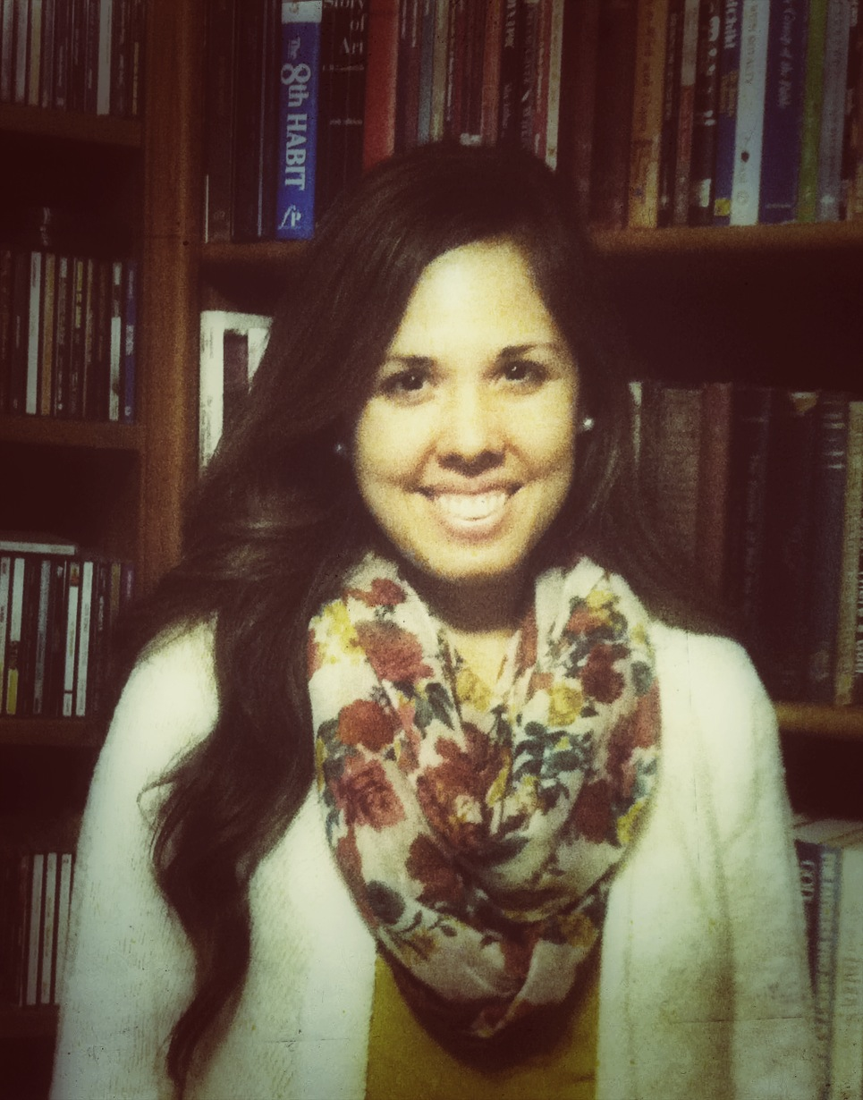
Amanda
Sanchez, Ph.D.
B.A., Pepperdine University
M.Ed., Vanderbilt University
Ph.D., University of Minnesota
Executive Director of CaCHE
Notes:
-Grew up with a heart for international missions and envisioned myself serving long-term on a foreign field.
-God providentially opened doors educationally for me, enabling me to finish my Ph.D. in International Development and Education at age 24. I also have a masters degree in Elementary Education and a Bachelor’s in Music Education.
-Over the course of my journey, God has transformed my thinking to recognize that it’s not just missionaries or full-time Christian workers who make his glory known in the world, but all of us through the different capacities in which we serve him in the world. I’ve learned that God’s ways are far more expansive than I ever imagined. This transformation in my thinking has direct implications for the way we approach education, especially education in the most marginalized and impoverished parts of the world.
-In the remainder of this presentation, I want to share what those implications are and how they might affect what we do with education in urban slums.

Slide 3
A Biblical Basis for Vocational Education
Theology of Education
Habakkuk 2:14
Education for the purpose of making disciples
The Role of the Church (Eph. 1:22, 3:10)
Theology of Vocational Education
The Hebrew concept of Avodah
The Patriarchs, Exodus 36:1-2, 1 Chronicles 28:21
1 Corinthians 7:17-24, 10:31; Colossians 3:17

Slide 4

Realizing This Vision
Moving from fragmentation to wholism: reintroducing our students to the reason they were created…
To be known by their Creator (chosen child of God)
To know their Creator (close relationship with him)
To be known as his (conformity to the image of Christ)
To make his glory known in the world (communicating his beauty and Truth through their vocation)
Notes:
As we saw in the previous slide, it is biblically true that there is no fragmentation between the sacred and the secular. God rules over everything and it’s all his. Ultimately, everything that exists is meant to reveal more of his beauty in the world. However, our modern education system often contradicts this fact by commoditizing people as if they were cogs in a machine rather than complex and capable human beings. I think the picture on the slide highlights this reality. It’s as if we have a distant memory implanted in us of being created for something more, but this longing is torn to pieces by the way we’re educated and by the way we view work. We need to start with helping our students become re-acquainted with why they were made and what their purpose on earth is.
This starts with introducing them to their Creator
Education today often views people in highly commoditized form

Slide 5

God’s love and grace in choosing the marginalized and oppressed
God’s desire to relate intimately with those who are his
God’s desire to conform his people into his image
God’s desire for us to manifest his character and Kingdom in the world
Notes:
Practically, this requires the bare minimums of

Slide 6



How can we do this through vocational education?

Slide 7

Serve the most marginalized and disadvantaged students
Help students grow in their relationship with Christ
Encourage a learning process that emphasizes growing in Christlikeness
Point learning back to how it can be used for God’s Kingdom purposes in the world
Prepare servant-leaders who go back into their communities to make a difference

Slide 8
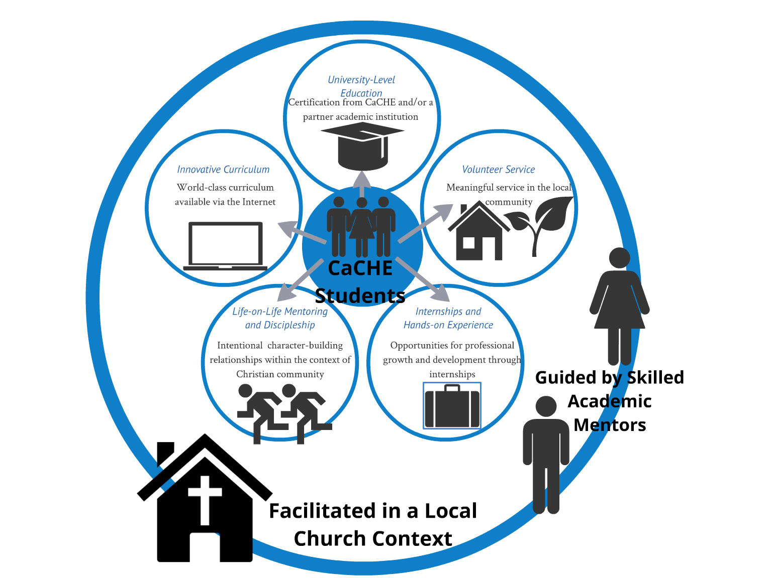
Notes:
http://www2.gcc.edu/cso/student/Documents-Guides/BiblicalFoundationsforVocation.pdf

Slide 9
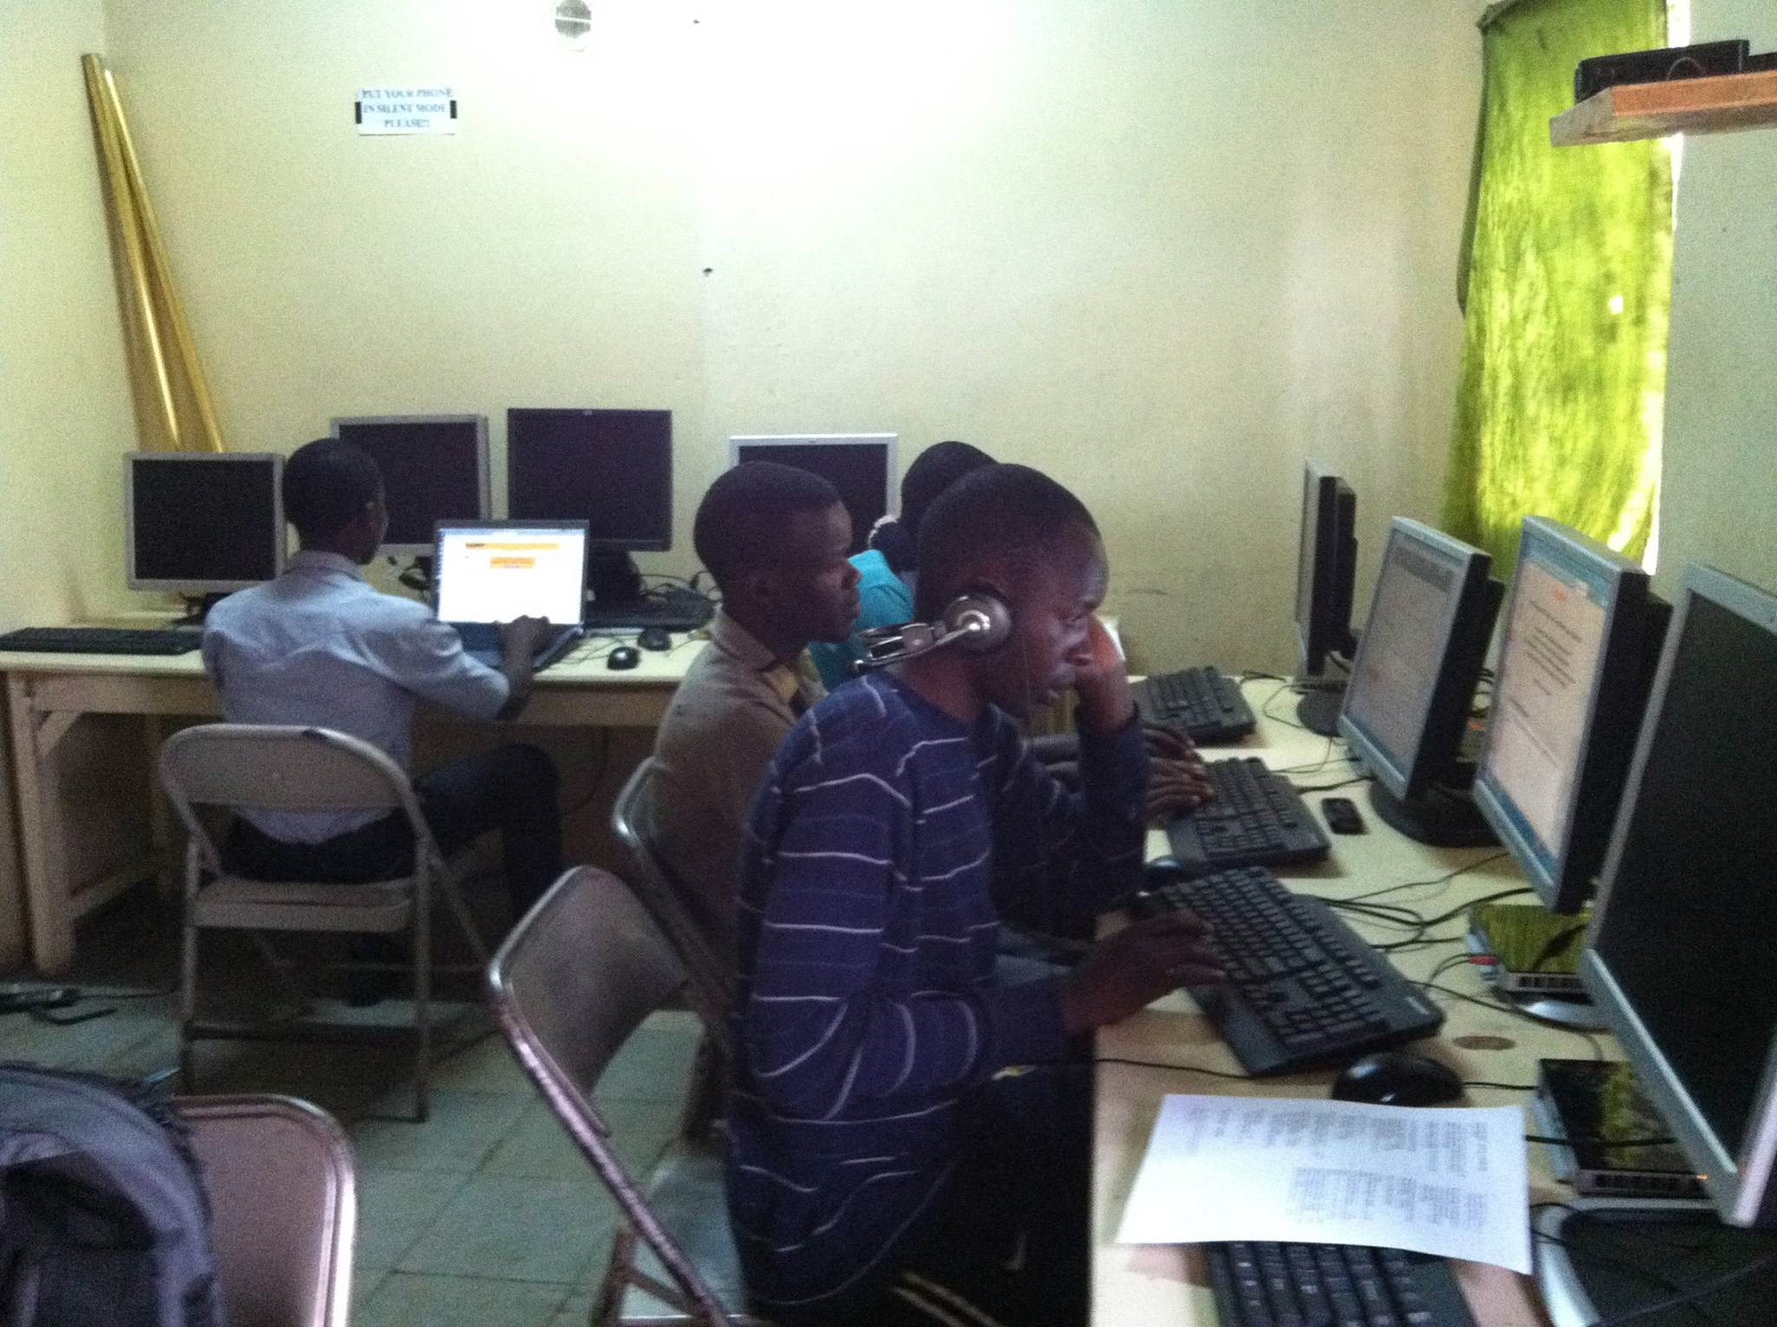
Students at the first CaCHE program in a slum community of Nairobi

Slide 10

“The Spirit of the Lord God is upon me,
Because the Lord has anointed me
To bring good news to the afflicted;
He has sent me to bind up the brokenhearted,
To proclaim liberty to the captives
And freedom to prisoners;
To proclaim the favorable year of the Lord
And the day of vengeance of our God;
To comfort all who mourn,
To grant to those who mourn in Zion,
Giving them a garland instead of ashes,
The oil of gladness instead of mourning,
The mantle of praise instead of a spirit of fainting.
So they will be called oaks of righteousness,
The planting of the Lord, that He may be glorified.” – Isaiah 61:1-3

Slide 11






A journey…
…with many moving parts…
…built upon Jesus Christ…
…and his Body, the Church.
We need you to help us understand how to strengthen this educational model…
…and perhaps to consider giving 2 years of your life to join us in this mission.

Slide 12
Learn more at http://cacheglobal.net.
Or
Contact me at amanda.sanchez@cacheglobal.net.

