Slide 1
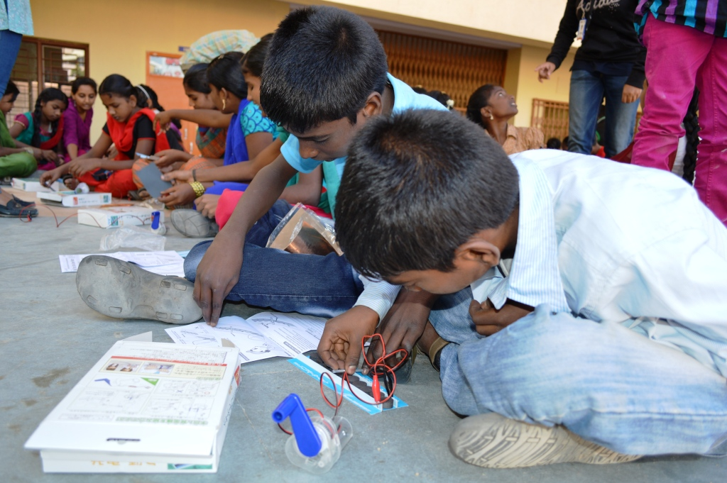
Public vs Private Schools Debate
Three views

Slide 2
The Global agenda is for Education for all through public schools some say that private schools among the poor is a better model. Which option is preferable?
Three views
Pro-private
Pro-Public
Mixed Model

Slide 3
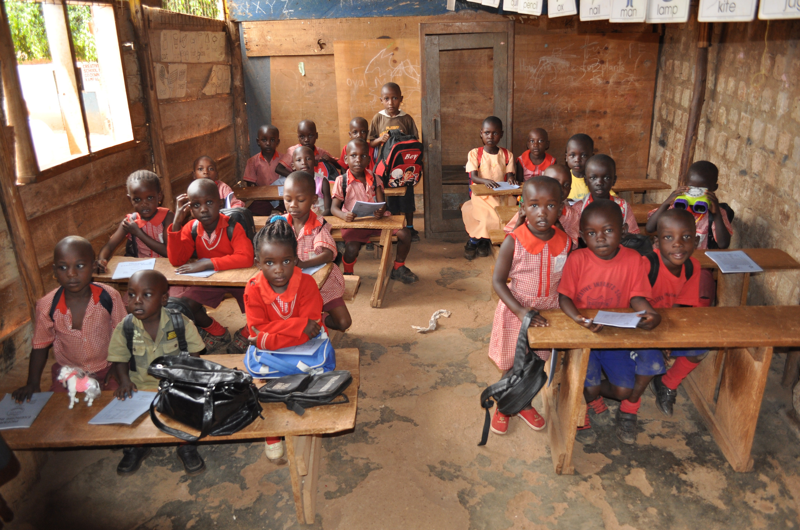
Public SCHOOLS
Can cater for more diversity in socio-economic background
Quality is continually evaluated and critiqued
but corruption can damage this
Significant infrastructure across a wider range of people and geography.
Sustainability requires resourcing that only governments can give
Ideally free public education for all

Slide 4
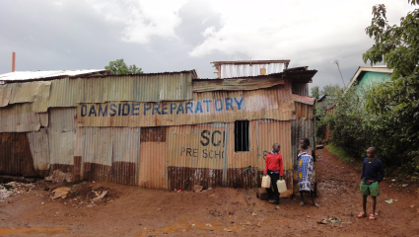
Private Schools
Fee-based accountability
Because they are enterprises, there is accountability.
Absenteeism is greatly decreased, as parents won’t pay fees for teachers who won’t show up
Class sizes are smaller, hence better outcomes.
No tenure in private schools – its based on quality
More intimate relationships – hence sometimes staff are kept because they are warm and friendly even if not good educators
Entrepreneurial attempts at education actually deliver vs public schools.

Slide 5
In Between Public and Private
Why are both necessary
Private Schools
engages with the overlooked
Engages the rich
Enables specialized opportunities
There needs to be a lead government sector, but also a private sector, to feed off each other.
It is a balance between commonality and uniqueness
Networks of public schools create the universalism of the culture. Networks of private schools plays into specialization of the culture.
Reliability of outcomes because of training, whereas private schools may not train teachers.

Slide 6
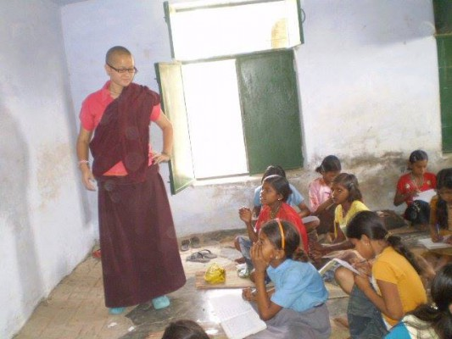
Government Limitations
Registered and unregistered.
Standardized testing
Governments can be extreme, hence universal education can produce extremism.
Images of work undertaken by participants from Leadership Seminars at CUTS, Varanasi in promoting basic education and ethics learning among slum-dwellers.

Slide 7
Resources

