Slide 1

Income and Expense
For Non-Profits

Slide 2

Income and Expense
Known as Profit and Loss in a For Profit Business
What can you tell from this spreadsheet?

Slide 3
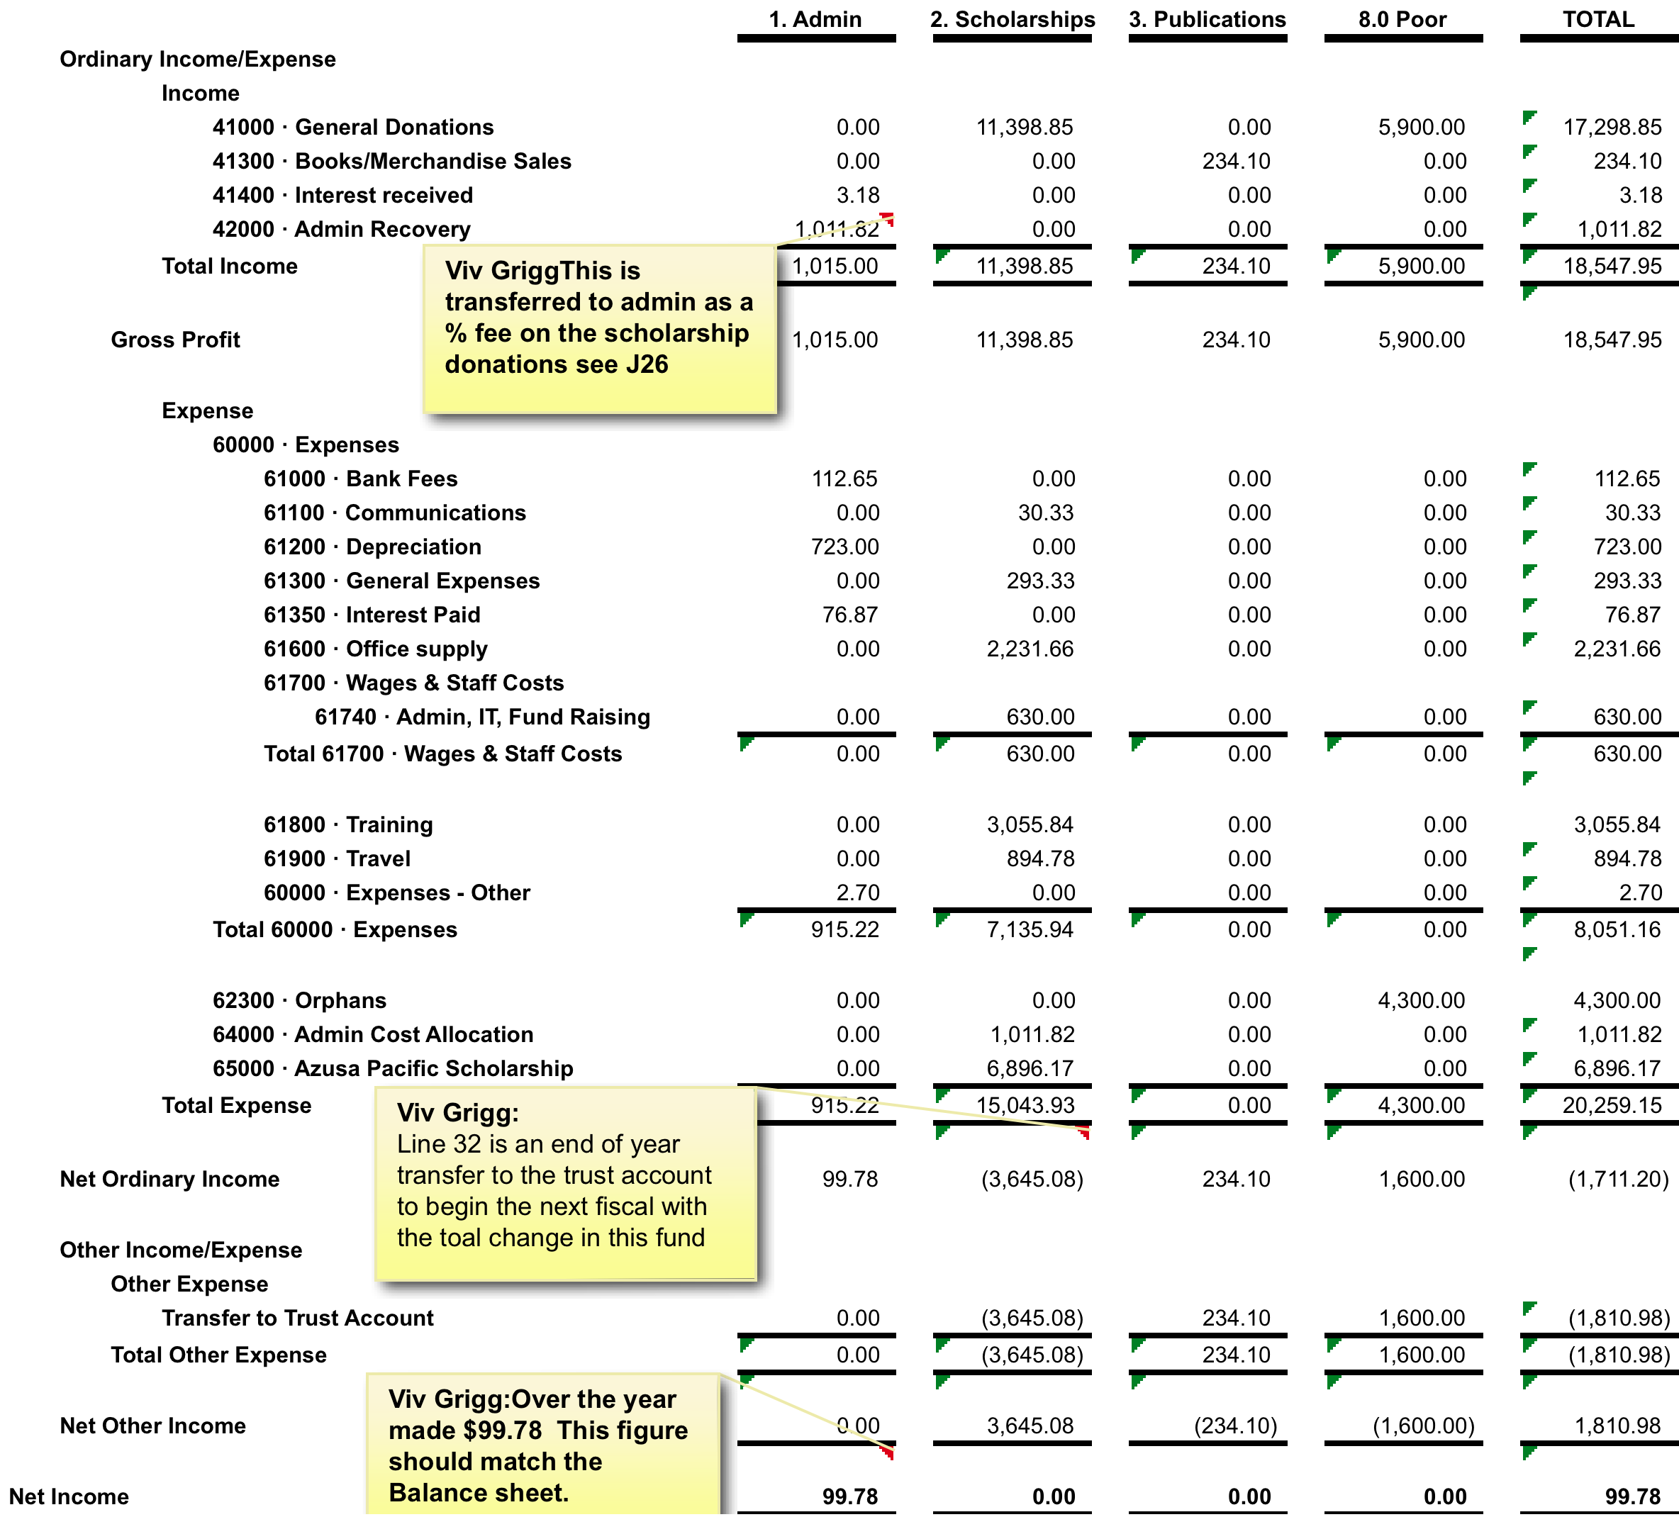
Income and Expense by Fund
Each fund is one column
(The admin column is not a fund but the operational costs of the NGO)

Slide 4

Connecting the Income and Expense with the Balance Sheet
The Beuaty of this double entry bookeeping system is that the income and expanse should match up with the cahgnes in teh balance sheet.

Slide 5

Cash Flow Analysis
You may be fine at the beginning of the year, but will you have enough cash, all through the year, to cover your expenses?
First you need a budget and in your budget mesh when you expect to receive income with when you expect expenses.
Then you need to compare your actual figures with your budget.

