Slide 1
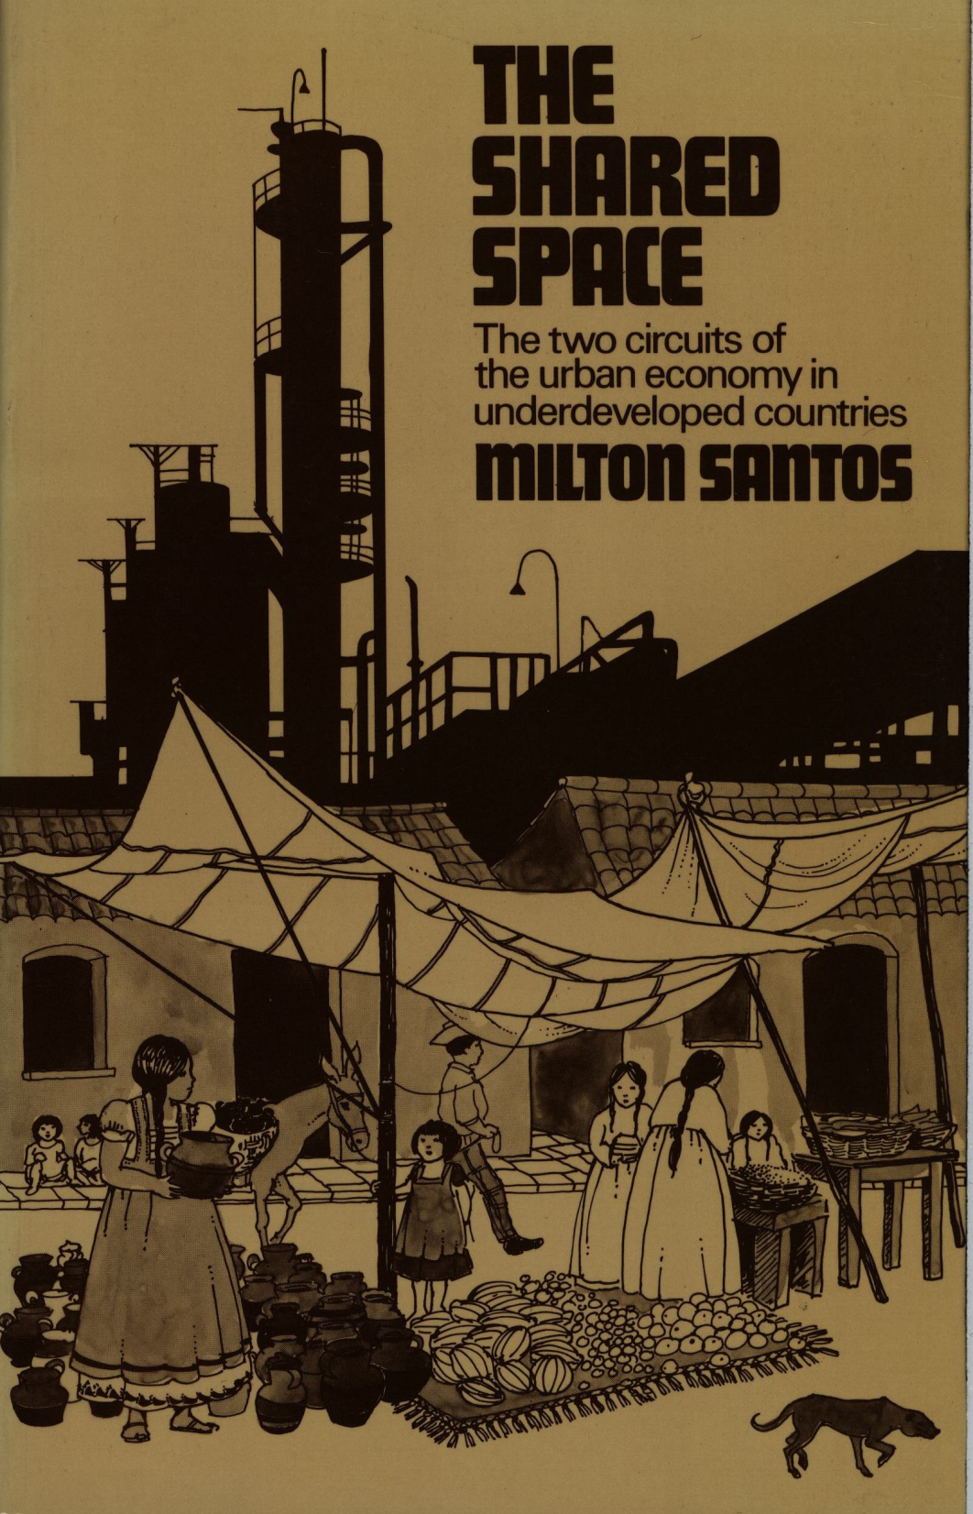
TUL560 reading: presentation by JON HENNING

Slide 2
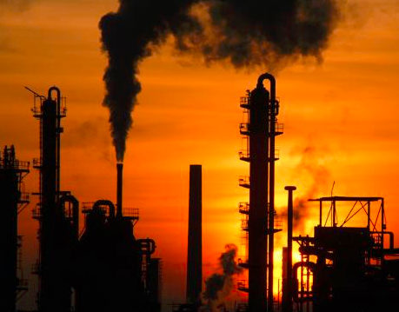
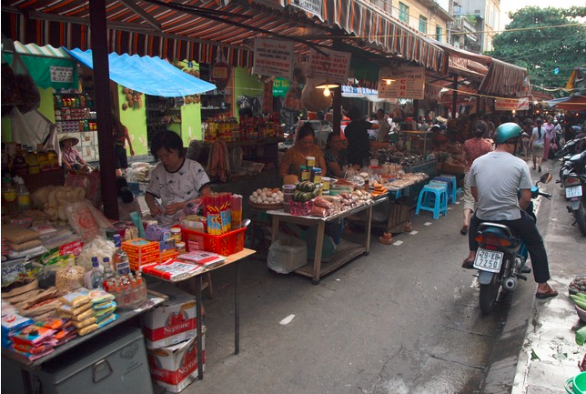
Two Circuits
Upper circuit /“modern circuit”
Lower circuit
Notes:
“The upper circuit is direct result of technological progress and its most representative elements are the monopolies” (p 8)
“The lower circuit consists of small-scale activities and is almost exclusively for the poor” (p 8)

Slide 3
Two circuits The major differences between the two’s activities:
Upper Circuit
Technology Capital Intensive
Organization Bureaucratic
Lower Circuit
Labor intensive
Primitive
Notes:
See chart page 22. Most of the data on this chart is fairly intuitive

Slide 4
Lower circuit
Distinction made in Chapter 3 between “The ghetto” and “Shantytowns”
The Ghetto (Industrial nations)
Job mobility limited
Government compensation- more secure poverty
Almost no lower-circuit in developed countries
2/3 World urban poor “Shantytown”(underdeveloped nations)
Labor is flexible/ adaptable
Much more insecure poverty
Notes:
Although both the ghetto and shantytowns are similar in that the residents find it difficult to find permanent employment.
“The Ghetto and the lower circuit” see page 29

Slide 5
The upper circuit
Imports and Exports
Notes:
Santos goes into detail of what the upper circuit does. Imports raw material, exports synthetic materials, etc.

Slide 6
The banks
Mediating Role- in the upper circuit

Slide 7
The state- upper circuit
There is a relationship!
Notes:
“In underdeveloped countries, the State allies itself with the upper circuit of the economy in order to achieve the technological modernization it so desires” (p 70).

Slide 8
conclusions
The existence of the two circuits points to the failure of the development planning theories of underdeveloped capitalist countries.
Statistical optimism looks to mask economic issues
Must protect the lower circuit’s ability to absorb the labor that the upper circuit is unable to provide. But it cannot remain as it is.
“…paradoxically, it is the poor who finance much of the modernization process, from which they reap so little benefit” (p 204).

Slide 9
Conclusions
The is the upward flow of capital from the lower circuit to the upper, that is not reciprocated.
Notes:
Santos lays out things that would need to happen in order to narrow the gap between the upper and lower circuits.

