Slide 1
Chapter 11: Designing Case Studies
Doing Research in the Real World
by David E. Grace

Slide 2
Case Studies
“A case study is a research strategy which is focuses on gaining an understanding of the dynamic present within single settings” (Eisenhardt, 266)
“relationship between a phenomenon and the context in which it is occurring” (Yin,267)
Case: the phenominan being studies
Explores:
subjects and issues where relationships are ambiguous of uncertain
Relationship between phenomenon and real-life context
Casual relationships vs descriptive
Needs
theological position and defined research question to focus research
Ability to interpret answers
Combines a variety of data collection methods (ie archives, interviews, surveys, and participant observation

Slide 3
When to use Case Study
Case studies
Answers a How or Why question
Add to understanding and extend experience
Increase conviction on a topic
Generates date that develops theory
Possible contexts
Evaluation of training program,
Organization performance,
project design, implementation,
policy analysis,
relationships b/w sectors or organizations

Slide 4
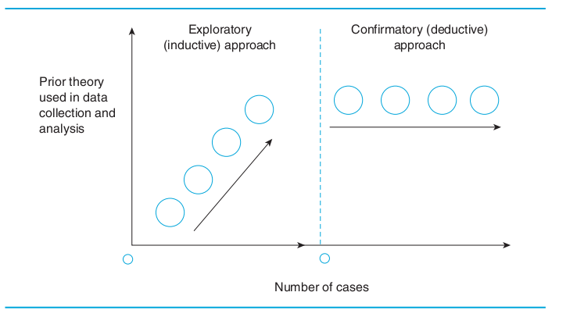
Inductive vs Deductive
Screen Shot 2016-05-23 at 2.48.15 P

Slide 5
Limitations
Questions of reliability, objectivity, and legitimacy
dangerous/difficult to generalize form single case
Time consuming and produce lots documentation
Results of a case study can not be assumed to generalized across larger population (as would be possible with experimental design)

Slide 6
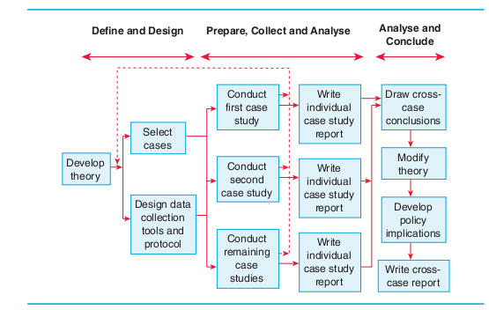
The Process of Design

Slide 7
1) Define: Develop a Theoretical Stance
Building theory from research
Topic is relatively new or there need to inject fresh perspective into well known theme
Start with theoretical framework based on past research
Literature Review
Provisional hypothesis or questions development,
Discover past research
identifying revival hypothesizes

Slide 8
Design Case Study
Select Cases
random selection unhelpful
polar of extreme types
Important that phenomenon is “transparently observable”
4-10 cases are ideal to generate theory and the volume is manageable
Designing unit of analysis
Ensure unit matches research objectives (ie process vs look or functionality)

Slide 9
Analyze and Conclude
Multiple Case
Each study is it its own study
Conduct within study analysis/detailed write up for each site to identify unique patterns
Converging evidence: data from one study replicates data from another
multiple pieces of evidence add to clearer overall picture
Negative instance: are helpful. They lead to continual revision of hypothesis and reveal

Slide 10
Analyze and Conclude
Cross-Case conclusions: Methods
Patterns across cases by searching similarities and differences
  Non-equivelant dependent variables
  Rival explanations (unexpected outcome
  Explanation building (compare findings to proposition, amend proposition and repeat)
  Time series( dependent and independent variables traced over time, predicted patterns compared with actual)
  Programme Logic Models: combines pattern matching and time series
Dimensions of previous research
Analyze by data source
Analytic generalization: ability to compare and contrast the results of the case study with an accepted set of principles or theory
If two of more are shown to support theory, the theory has been replicated

Slide 11
Analyze and Conclude
Case Study Construction
Step 1: Assemble raw case data
Step 2: (optional) construct case record, organize, classify edit raw data (condensed version of each case)
info is collected systematically.
Presentable for other researchers to be able to review it as well as final report
Allows for the evaluation of reliability through case
Step 3: Write case study narrative (Linked back to case record, chain of evidence, allow for evaluation by other researchers)
Types of reports, depends on audience
Reflective report: use of literary devises, bring life to case
Analytical report; more detached writing style, conventional structure (ie linear report
Linear analytic report, comparative(multiple time, compare and contrast), chronological, theory building, suspense(begins with answer, good for business)

Slide 12
Types of Case Studies
Single Case Holistic: one single case examined at holistic level, used ot test hypothesis or theory or a extreme or revelatory case
Single Case, embedded: single case with a few embedded units of analysis (ie process, multiple perspectives, evidence of)
Multiple Case, Holistic: used to improve reliability and generalizability of a study. The goal is to replicate the findings within the same case
Multiple Case, Embedded: multiple units of analysis are used again the goal is replication

Slide 13
Validity and Reliability
Construct validity: the extent to which the study investigates what is sets out to investigate (difficult ot define constructs being investigated)
Possible Challenges
Internal validity: causal relationship, making inferences
External Validity; representation of population (fit to population and systematic selection)
Reliablity: can findings be replicated by another researcher doing same study

Slide 14
Analysis Methods
analysis based on theoretical proposition (make choices about about what is worth investigating and what to ignore
Develop descriptive framework for findings (no obvious framework, identify types of cases for further analysis
Explaination building

