Slide 1
Life Transforming Thesis Proposals
They begin with murky ideas in the darkness of soul in the depths of the depravity of the city
Notes:
This template can be used as a starter file for a photo album.

Slide 2
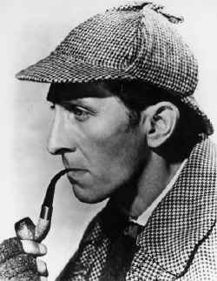
The Sherlock Holmes Approach to societal transformation
Finding the details to preclude
the fall of an empire,
the loss of a city,
the freedom of maids enslaved by evil forces.
Introducing the Thesis Proposal

Slide 3






The pre-thesis is the thesis proposal
Before
After
Tone
Saturation
Color
Can you spot the Difference simply because you are brilliant and have flashes of insight? Or by the Holmes method: logically laying out a process form which you can deduce that difference? The proposal makes the decisions for an effective plan prior to investing heaps of time following rabbit trails to failed research.

Slide 4






Before
After
Contrast
Brightness
Sharpness
Prior planning, testing of thesis, mapping process allow you to change the contrasts, the brightness of your ideas, and sharpness of your focus.

Slide 5
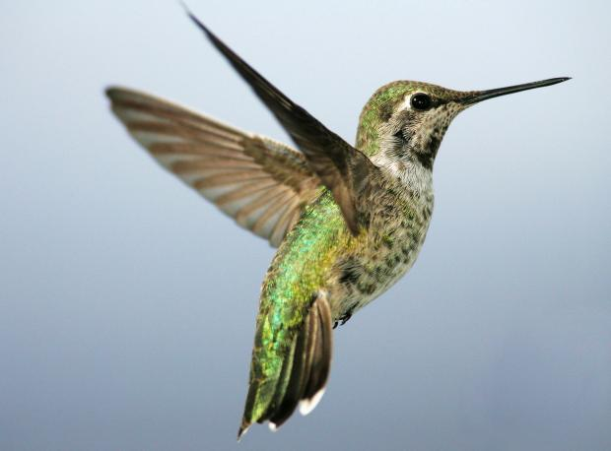
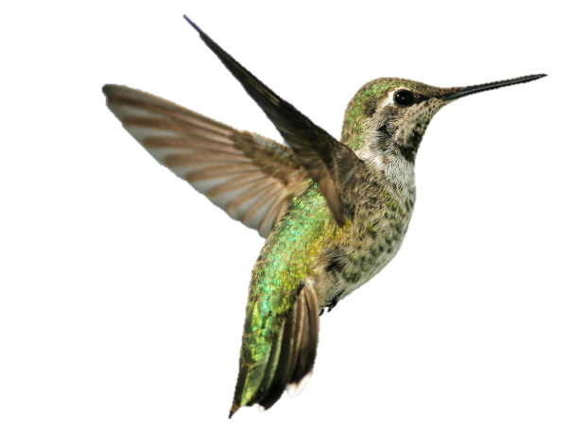
T
The Research Question: Focus on the Core of Your Problem
Background Removal allows you to quickly isolate the items in your core question. Noise in engineering is anything that is not that core wave you are transmitting. In pop music called music! (but no point to go there).
Reduce your problem or question to two variables an the measurable relationship between them (in a context). The rest is noise.
In the write up some of the noise may become very significant , especially if your study is an exploratory study. Serendipities are the mother of breakthroughs. But don’t plan on that.

Slide 6


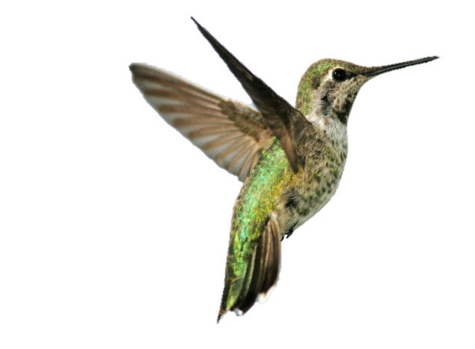
In the process of layering multiple variances of the variables on, first, the same, then different backgrounds (contexts), you can create nuances that affect the value of your data – use this iterative approach to focus on exactly what it is your are searching for.

Slide 7



The Introduction
Dramatic enthusing of your backers can be achieved by contrasting an image of the need with the possibilities of understanding that leads to solutions - but use artistic effects to touch the emotions – story, drama, event, poetic nuanced paragraphs that capture the heart – never lose the opportunity to inspire.

Slide 8

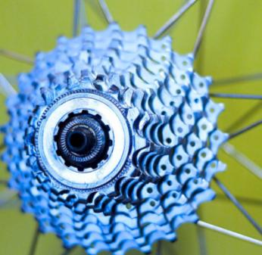

templates
Thesis Topic: Optimizing the Design of Mechanical Flowers
New layouts bring
creativity to your presentation
Your thesis needs to be in a specific academic style, but your proposal can give people pushing papers a few moments of happiness!!!

Slide 9



Methodology: Fit? Extent? Viability? Manageable outcomes? Expected valid data?
2
1
3
Logically connecting the two variables?
A narrow keyhole within the broad field and possible data around which to discuss?
Or a cycle trying to fit a horizontal wall?

Slide 10
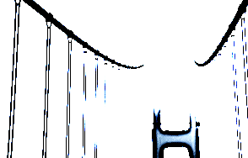

Methodological Drift: test, flex, nail it
You start with a logical plan, but it morphs as you deal with reality until you realize there is another way to go through this keyhole of narrow data that works

Slide 11





Deciphering the Data
But it doesn’t fit my frame! But there is data missing?
Don’t fudge. At times interpolate, but justify this clearly.
Go back and get more? In an action reflection process you can change the question in the next round

Slide 12
Planning to Decipher the Data
In your plan set up your rubrics for analysis. Calculate the number of pieces of data you will need to input and the extent of analysis that will be needed for each. Calculate your time allotments and put into your Gantt Chart.
Usually this is missing in a proposal. Result: stressed out people.

Slide 13






Do NOT pass in your proposal unless you have done
Spelling check
Grammar check
Consistency check of all footnotes and bibiographic entries, including page numbers when referenced
Consistent layout with three levels of headings, page numbers, paragraph formatting, fonts.
Or it will be returned to you ungraded!!!

Slide 14

Transitions
Check all transitions between paragraphs. A paragraph is an idea. The first sentence is the idea. The second expands, or explains or extends. The last sentence links to the next paragraph.
No paragraph over 6 lines
Did you check the readability statistics?

Slide 15

Titles
Before your Revisions: boring, non-communicative, nonsensical, nonchalant
After
Captivating
Creative
Clear Concept
Titles Titilate Teachers to Track Through to Thend.
3 Levels, Use Template Formatting

Slide 16

Reduce the number of words
After you have put it all together go through and eliminate 20% of what you have written. This discipline will tighten your English and your argument. Plan to rewrite four times. The best writers do so seven times

Slide 17





