Slide 1
Graphically Formatted Thesis Proposals
They begin with murky ideas in the darkness of soul in the depths of the depravity of the city
Notes:
This template can be used as a starter file for a photo album.

Slide 2
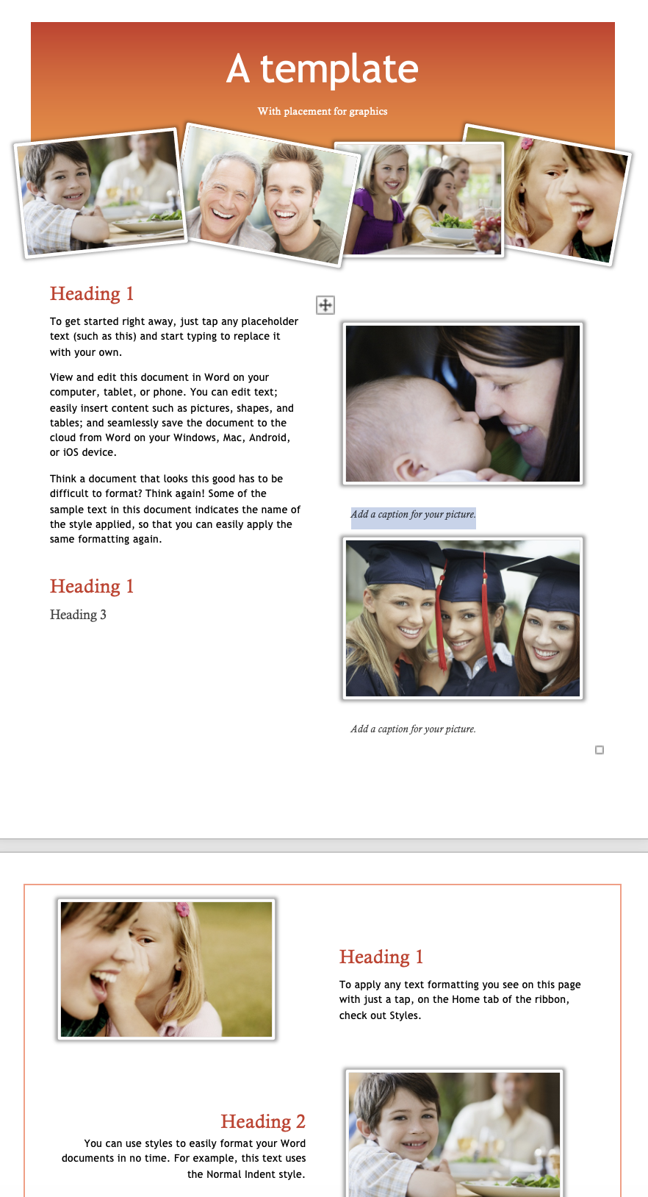
Word templates for 21st C
New layouts
Single Spaced. We no longer grade with pen, but on the computer, so double spaced is not needed.
Your thesis needs to be in a specific academic style, but your proposal can give people pushing papers a few moments of happiness!!!
Photo place holders
H1, H2, H3 formatted
Columns
Boxes

Slide 3
One per page is enough
Placing pictures
Title: Mechanical flowers
Placement of Pictures – one per page?? Balance??
Figure 1: Optimizing the Design of Mechanical Flowers
No Messy location
No messy stretching
Keep the ratios
Leave space
Use Word Insert Caption to add a description
Add another Caption option to add Titles
Position the picture with Space
The picture must extend your logic, so link to it in the text

Slide 4
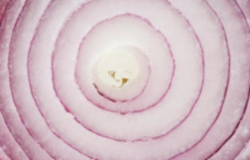
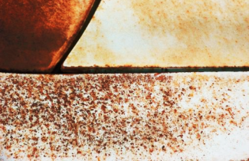
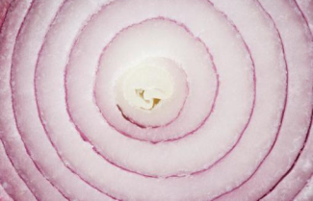
Titles
Before your Revisions: boring, non-communicative, nonsensical, nonchalant
After
Captivating
Creative
Clear Concept
Titles Titilate Teachers to Track Through to Thend.
3 Levels, Use Template Formatting

Slide 5
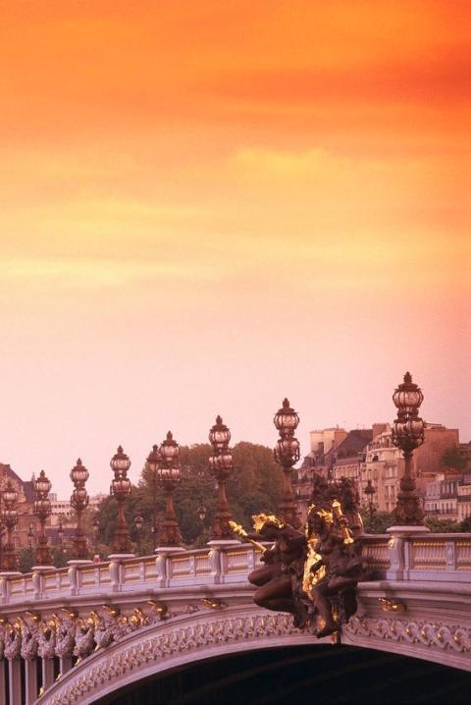
Reduce the number of words
After you have put it all together go through and eliminate 20% of what you have written. This discipline will tighten your English and your argument. Plan to rewrite four times. The best writers do so seven times

