Slide 1
Paulo freire
A Glance at his Pedagogy

Slide 2
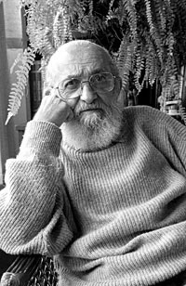
BIO
-b. 1921 in Pernabucco, Brazil
-middle-class family → poor family
-law school
-teacher→ social services
-300 farmers literate after 45 days
-exiled to Bolivia
d. 1997 in Sao Paulo

Slide 3
Friere’s vision
Pedagogy of the Oppressed
(1968)

Slide 4
Key terms
Oppressed – the elite: “necrophillious,” objectifying, mechanizing, attempting to preserve the status quo
Oppressor – the proletariat, held back and held down by external situations devised by elites
Critical consciousness – awareness of one’s situation
Banking Education – traditional education, oppressive
Problem-posing Education – conversation about problems beginning with local knowledge, thought-action cycle
Partnership – egalitarian relationship bt teacher and student; mutually learning

Slide 5
Main ideas
Education as Liberation and Reclamation of Humanity
Liberation from oppression
Liberation begun through awakening “critical consciousness”
Teacher does not ‘teach’ but facilitates a reciprocal pattern of thought and action (theory and praxis) through dialogue
With critical consciousness gained, communities ideally organize themselves, armed with an understanding of who they who, why their oppressed, and

Slide 6
fin

