Slide 1
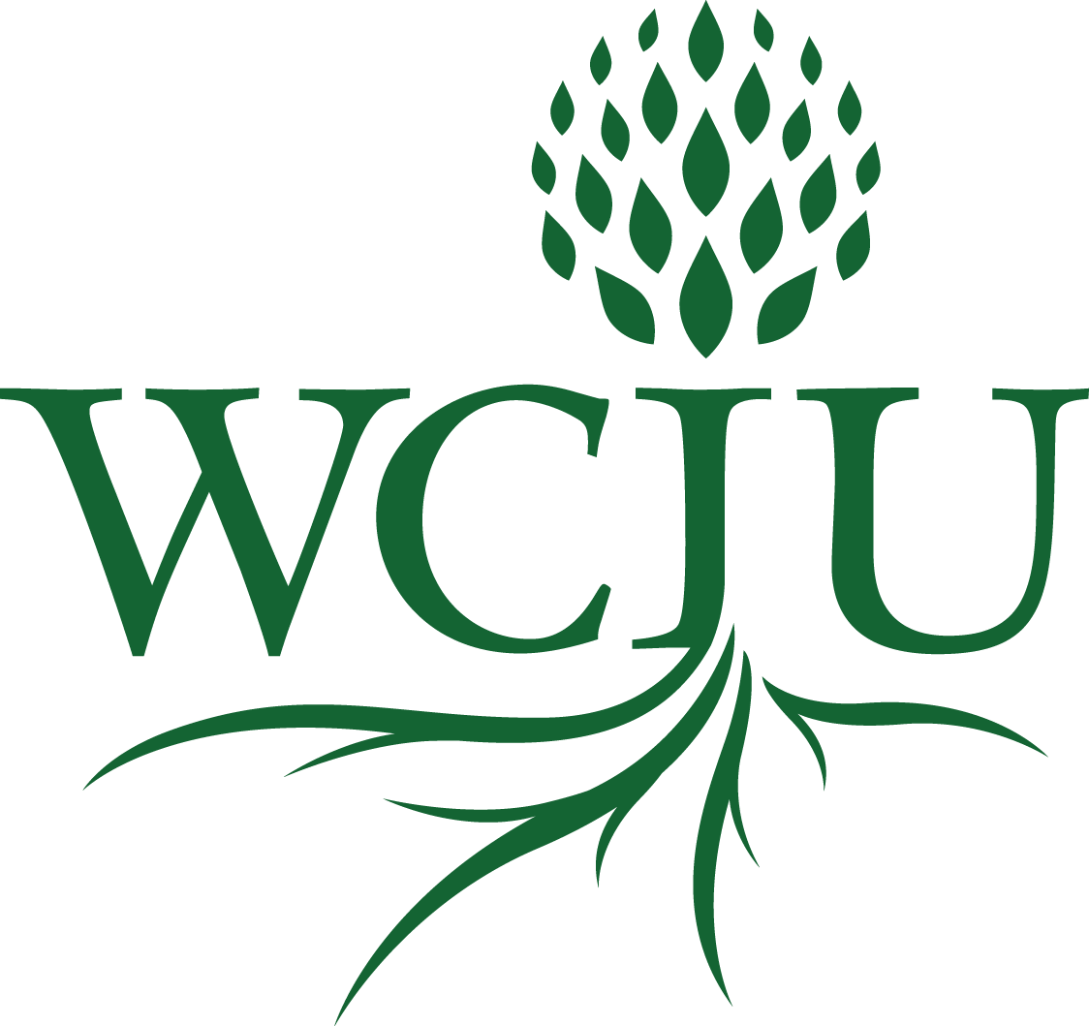
Qualitative Research Methods 5. Participatory-Action Research (PAR) as Transformational Conversations
A course in the MA in
Transformational Urban Leadership
Notes:
NOTE:
To change the image on this slide, select the picture and delete it. Then click the Pictures icon in the placeholder to insert your own image.

Slide 2
Wonder at this Phenomenon
Become a Philosopher

Slide 3
Experience Living in this Community?
Creating a People Movement?
Forever Seeking Activist Solutions?
Become a Participatory Action Researcher
This Photo by Unknown Author is licensed under CC BY-NC-ND

Slide 4
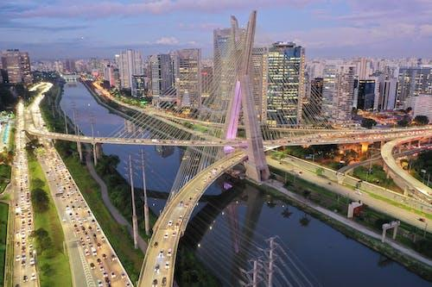
William Carey International University
OUR MISSION
innovative distance education
with scholar-practitioners
Engaging in transformational solutions
at the roots of human problems around the world.
OUR VISION
For a verdant and flourishing world, ripe with wholeness and peace for all peoples.

Slide 5
Social Constructivist Research?
Theoretical Framework
Theological PAR
PAR is Finding God at Work
Aiding the People
To See the Social Construction of the Moral Issues
To Find God’s Pathways Forward
To Mobilize Action and Decision-making
to Follow His Pathways
And in finding his ways to come to know him
Theological Foundations
At its heart research is moral
Moral outrage
Moral agenda
Moral advocacy

Slide 6
Beginnings of PAR
Prominent lineages:
Psychologist Kurt Lewin and his work to develop what he termed “action research”
Latin American popular social reform movements informed by the thinking of Paulo Freire.
These influenced thinking on:
adult education research
the Civil Rights Movement
The Participatory Research Network created in 1978, based in New Delhi.

Slide 7
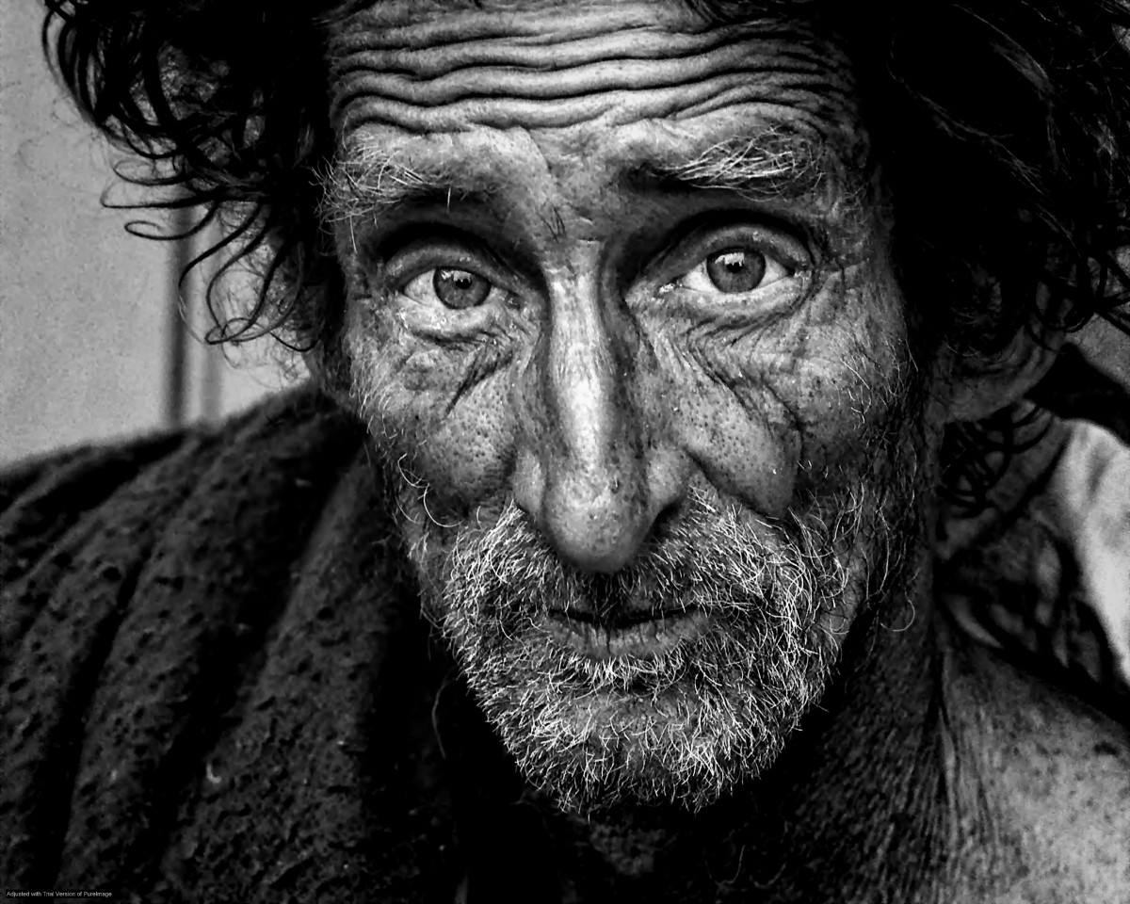
REsearch for What?
Theoretical exploration of an issue? E.g.my paper on post-postmodernism
Anthropological analysis of the mazeways of the mind of a culture:
Socio-economic Description of an issue, situation or problem. E.g. Alvins description of microfinance in Kibera. With 10 variables, what are the problems, optimizations. There are no solutions, but many perspectives and potential implementations.
Solution of an unanswered engineering problem. How do we design the eyes of the moon-rover?
Action Research as part of a change process. It doesn’t just describe. It involves action. Testing, validity occurs within the process.
Participatory Research as a democratization of knowledge production in the processes of such change.

Slide 8
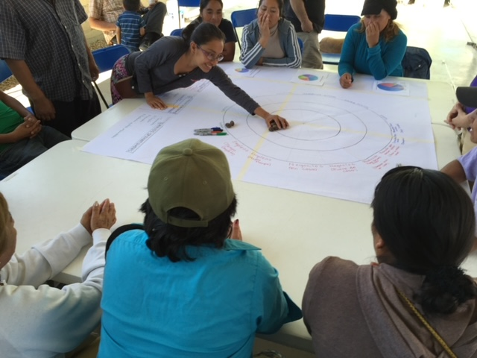
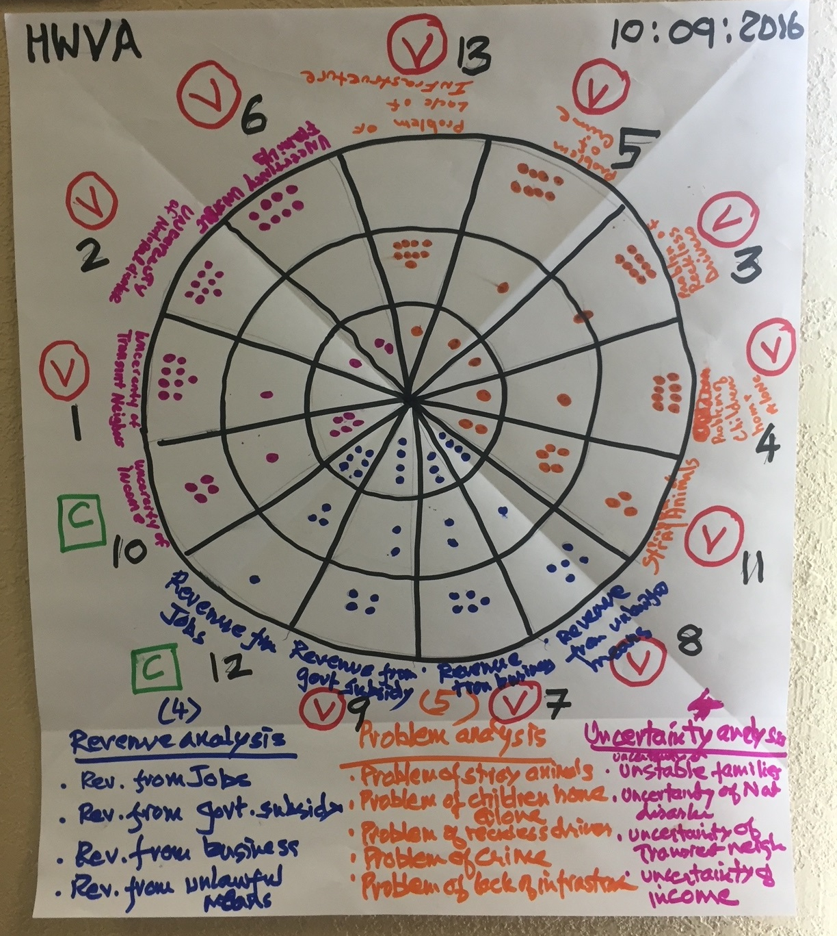
Locus: Community/Organization/ Institution/Movement
Communication: Oral and Academic Writing
To Whom: Decision-makers

Slide 9
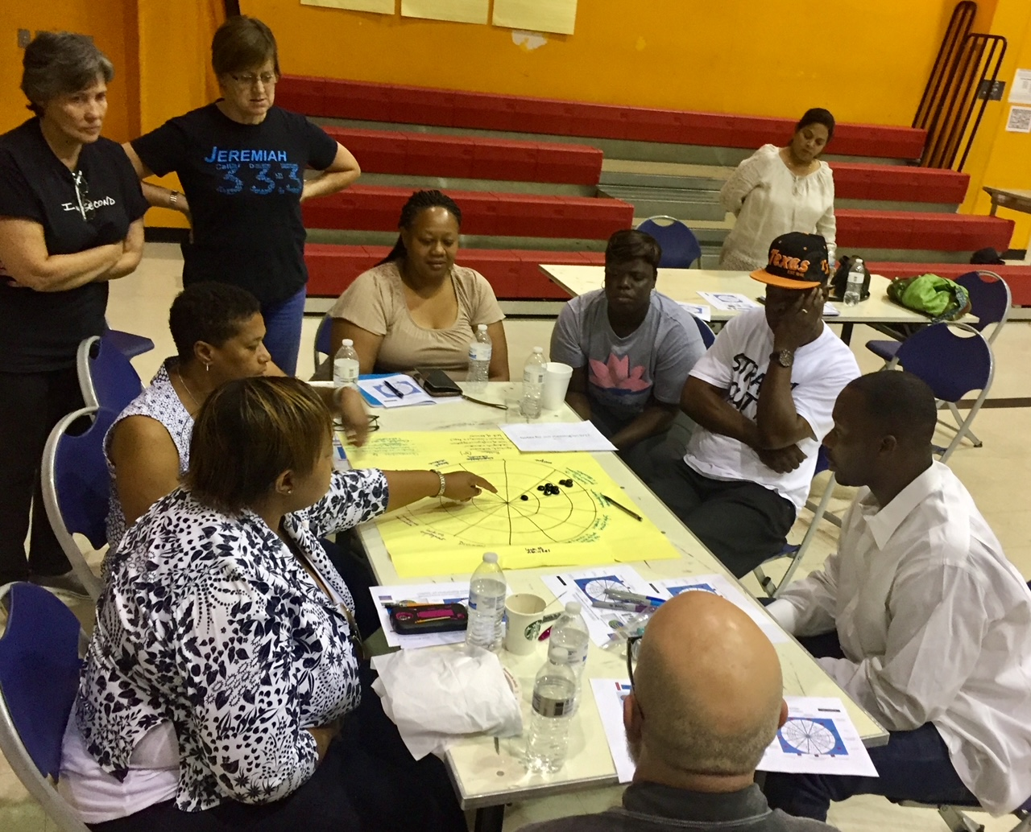
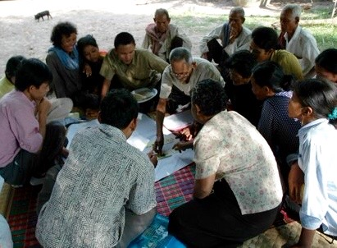
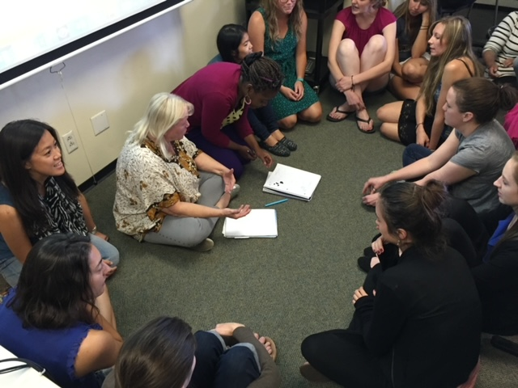
Participatory: Design, Process, Outcomes
Process and Outcomes: Community Action
Research: New Knowledge Owned by the People
P
A
R
Communication: Oral and Academic Writing
Theological Integration: Transformational Conversations/ Consultations

Slide 10
Participatory: Design, Process, Outcomes
Process and Outcomes: Community Action
Research: New Knowledge Owned by the People
Locus: Community/Organization/ Institution/Movement
Communication: Oral and Academic Writing
Theological Integration: Transformational Conversations/ Consultations

Slide 11
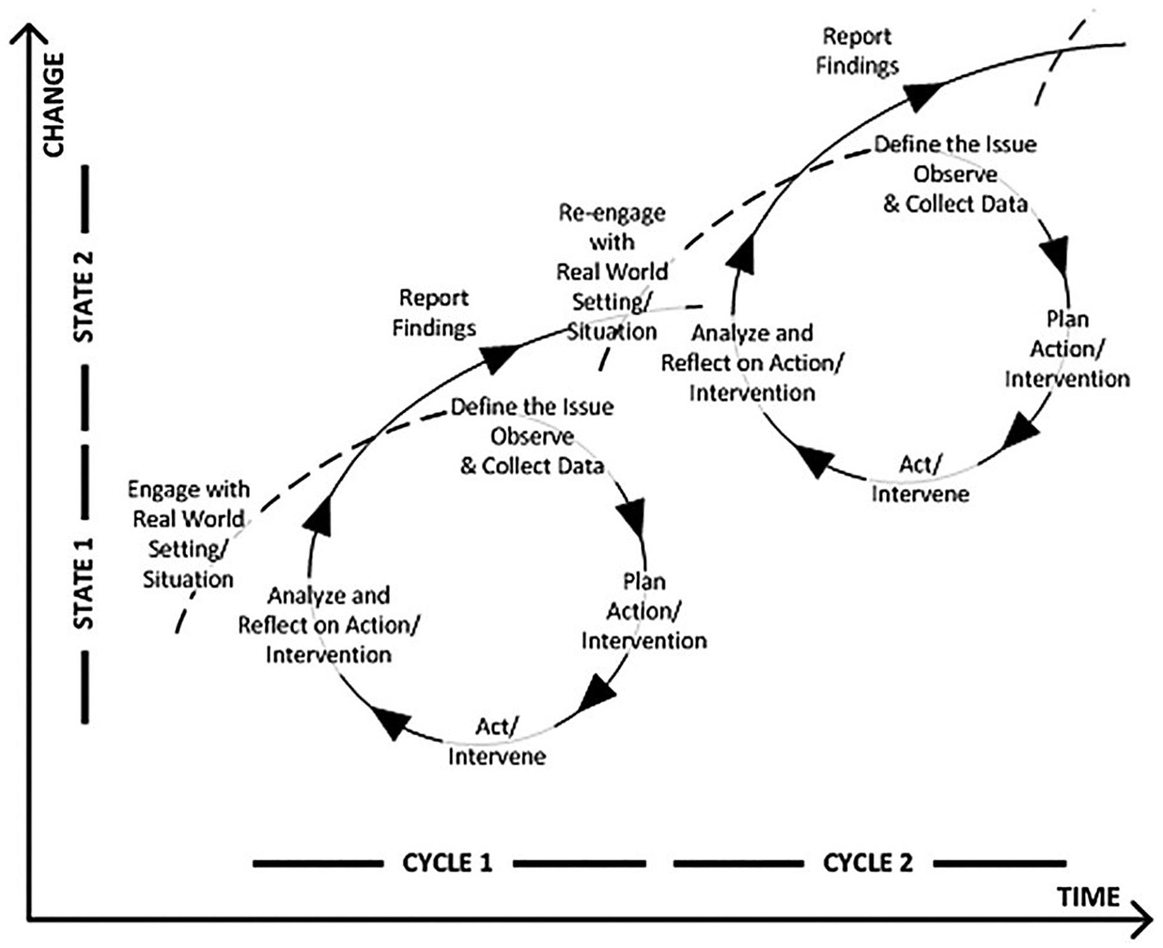
The Hui as PAR
This Photo by Unknown Author is licensed under CC BY

Slide 12
The Double Whammy: Action-Reflection at the Operational Level, New theory at the PhD level

Slide 13
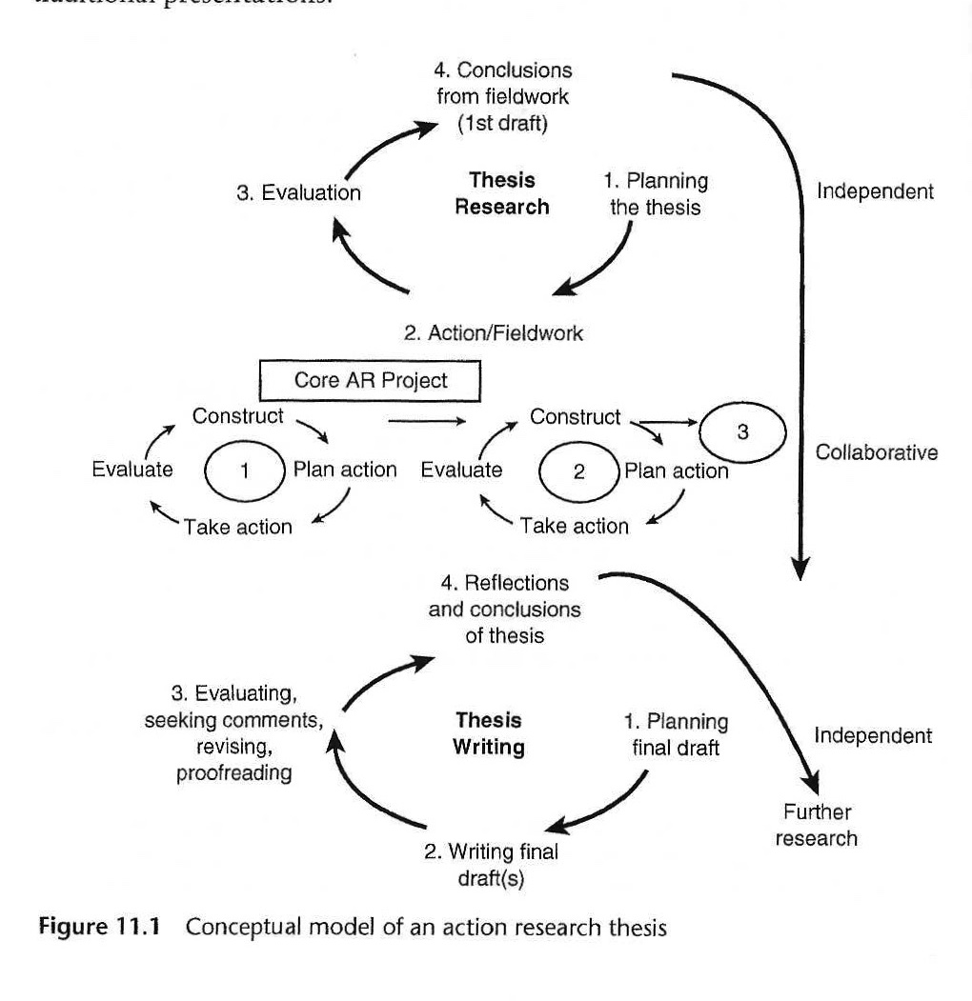
PAR & Academic Research Process

Slide 14
Interviews vs Focus Groups vs Consultations
METHODS WITHIN THE PROCESS (FRAMEWORK)
Characteristics | Interviews/ Storytelling | Focus Groups | Consultations
Number of Persons | 1 or 2 or family | 5-12 | 20-45
No needed | Story-telling 10-15 Analytical Questions 30+ | At least one per cycle of the PAR | 1-5
Definition of the issue | Well Defined Focussed questions, though open ended Thin truth | Can go different directions | Multiple Perspectives on Central issues May result in consensus or not Significant Deviations Thick Truth
Researchers role | Set up, do interviews, analyze | Needs to manage group dynamics well, | Preplanning as part of team to accomplish some level of consensus about the issue at hand.
Analysis | Some aspects quantitative Story checking Searching for Themes Coding Comparing with theory. | Qualitative Extensive write ups Generating theoretical frameworks | Presentations plus responses and discussions Integration into conference proceedings Community identification of themes. Creating theory

Slide 15
Interviews vs Focus Groups vs Consultations
METHODS WITHIN THE PROCESS (FRAMEWORK)
Characteristics | Interviews/ Storytelling | Focus Groups | Consultations
Selection Criteria | Clear selection based on defined criteria | Tricky: ideal spread vs organizational reality and motivation | Clear. Presenters, Participants, Auxiliaries
Support People | Translator or Research assistant | Organizational Team | Full Consultation team, editors, web designers, recruiters, database management, evaluators
Write Up
Analysis

Slide 16
How do Consultations fit with Process? 8 Consultation Outcomes
Action Process?
Research Process?
Leadership/Decision-making Process?

Slide 17
Transformational Conversations as Theological PAR: 1. Locus
Decide: Is your thesis to be:
A practical theology thesis, developing theology from among the people (giving you credibility in theological circles)?
An anthropological, or sociological or economic or strategic thesis, based on a theological foundation (Giving you creditbility in a discipline)?
A process of walking with God (aka Theology), as he takes grains of wheat and prospers them, thus identifying spiritual principles at each phase of the process (Giving you praxis theology and credibility with the people and with ot her workers in similar contexts?

Slide 19
Alternative models for Alvin’s Research
Standard Sociological Descriptive Re-search Approach
Ten problems around savongs groups and outside resources
Sampling: 6 organizations, xx projects from each. Yy people.
Surveys
Statistical analysis of answers
Results to organization leaders
Will they implement recommendations?
What would an anthropological approach be?
What is the site?
What would paarticiaptn observation look like?
How would that be backed up with focus groups, economic analyses?
What would be an alternative PAR approach?
Basic Principles?
Who designs process?
What would be the questions they wish to research?
Who owns the results? Will they implement.
Which methods might be part of the process? Anthro, Sociological? Stats analysis of a survey? Field notes? Consultations? Focus groups? Historical studies?
What would the multiple cycles likely be?

Slide 20
Participatory action research
PAR-CT
= PAR infused theology in action
This Photo by Unknown Author is licensed under CC BY-SA

Slide 21
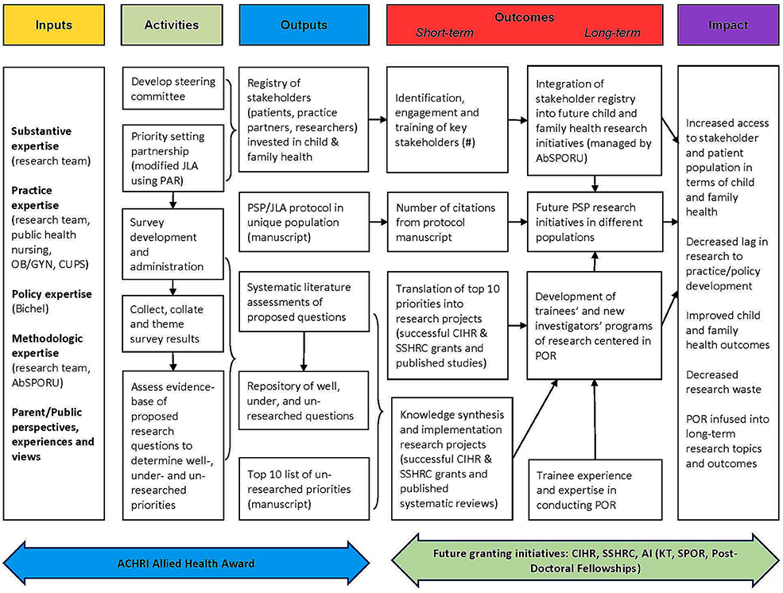
AN Example of large institutional PAR Will you be inside or outside of an Organization? A movement? A community

Slide 22
Evolving Ideas in Evolving Change Processes

