Slide 1
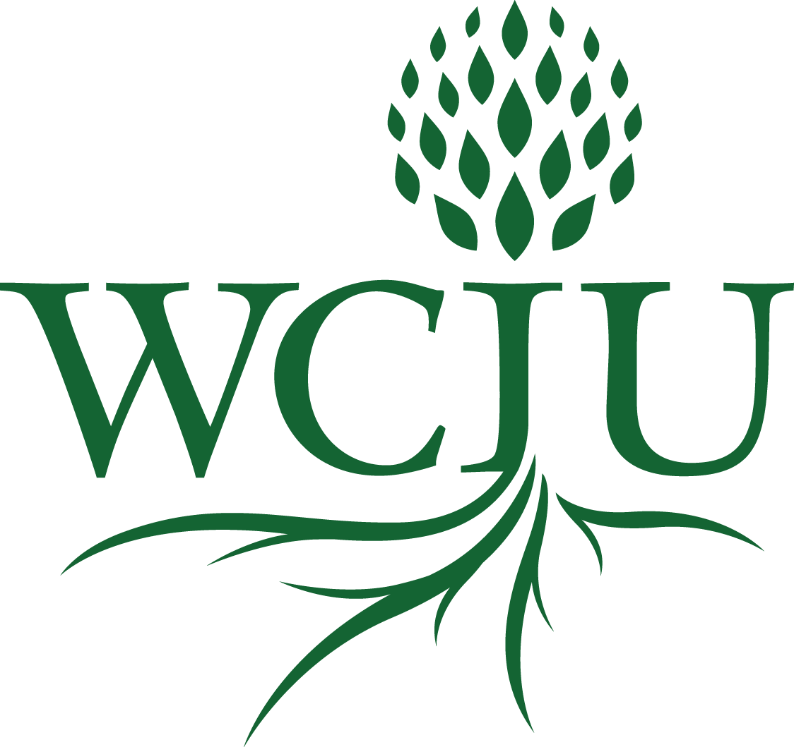
Qualitative Research Methods 5. Participatory-Action Research (PAR)?
A course in the MA in
Transformational Urban Leadership
Notes:
NOTE:
To change the image on this slide, select the picture and delete it. Then click the Pictures icon in the placeholder to insert your own image.

Slide 2
Wonder at this Phenomenon

Slide 3
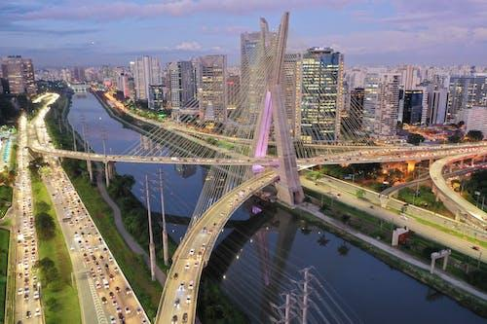
William Carey International University
OUR MISSION
innovative distance education
with scholar-practitioners
Engaging in transformational solutions
at the roots of human problems around the world.
OUR VISION
For a verdant and flourishing world, ripe with wholeness and peace for all peoples.

Slide 4
Social Constructivist Research?

Slide 5
Defining Qualitative: What is Truth?
1. In the mind? Truth is internally defined. Like love. Perceptive Capacity: As a child of 1, we found out that when an object disappears behind another, it may still exist. Tested mental constructs: Dad: Go and play in the bush, it will help you learn to adventure. Mum: Do not go into the bush, you may get lost The bush is the same. One or both constructs are true perceptions 2. In the world? Truth is external reality In the mind of the community? Only if transmissible generationally: In written documents
Only if transmissible by tradition: oral traditions

Slide 6
Exploring Truth in a Social Context?
In the mind of the community?
Only if transmissible generationally: In written documents
Only if transmissible by tradition: oral traditions; myths, stories, proverbs, parables, history
The Bible is a written collection of traditions about truth.

Slide 7
What is Truth?
In the mind of the community?
In urban /modern academic culture: Only if transmissible generationally: In written documents
In peasant/tribal culture: Only if transmissible by tradition: oral common traditions
Primarily in the Bible?
Tested against the Bible?
The Bible is one source of truth and foundational in matters of faith and practice
Only in the Bible?
The Bible is a collection of oral and written traditions about truth.
Truth is:

Slide 8
What is Truth?
The Bible is literal dictated truth - fundamentalism
Perspectives on the Scriptures & Truth
Or The Bible is and contains revealed truth -evangelicalism
The Bible is the best of human understanding of truth - liberalism
Or The Bible is revealed truth, but written by human beings, hence its literature needs to be interpreted according to the genre and culture in which it was written. Along with truth from revelation, there is humanness – mainstream Protestantism, Catholicism, evangelicalism.

Slide 9
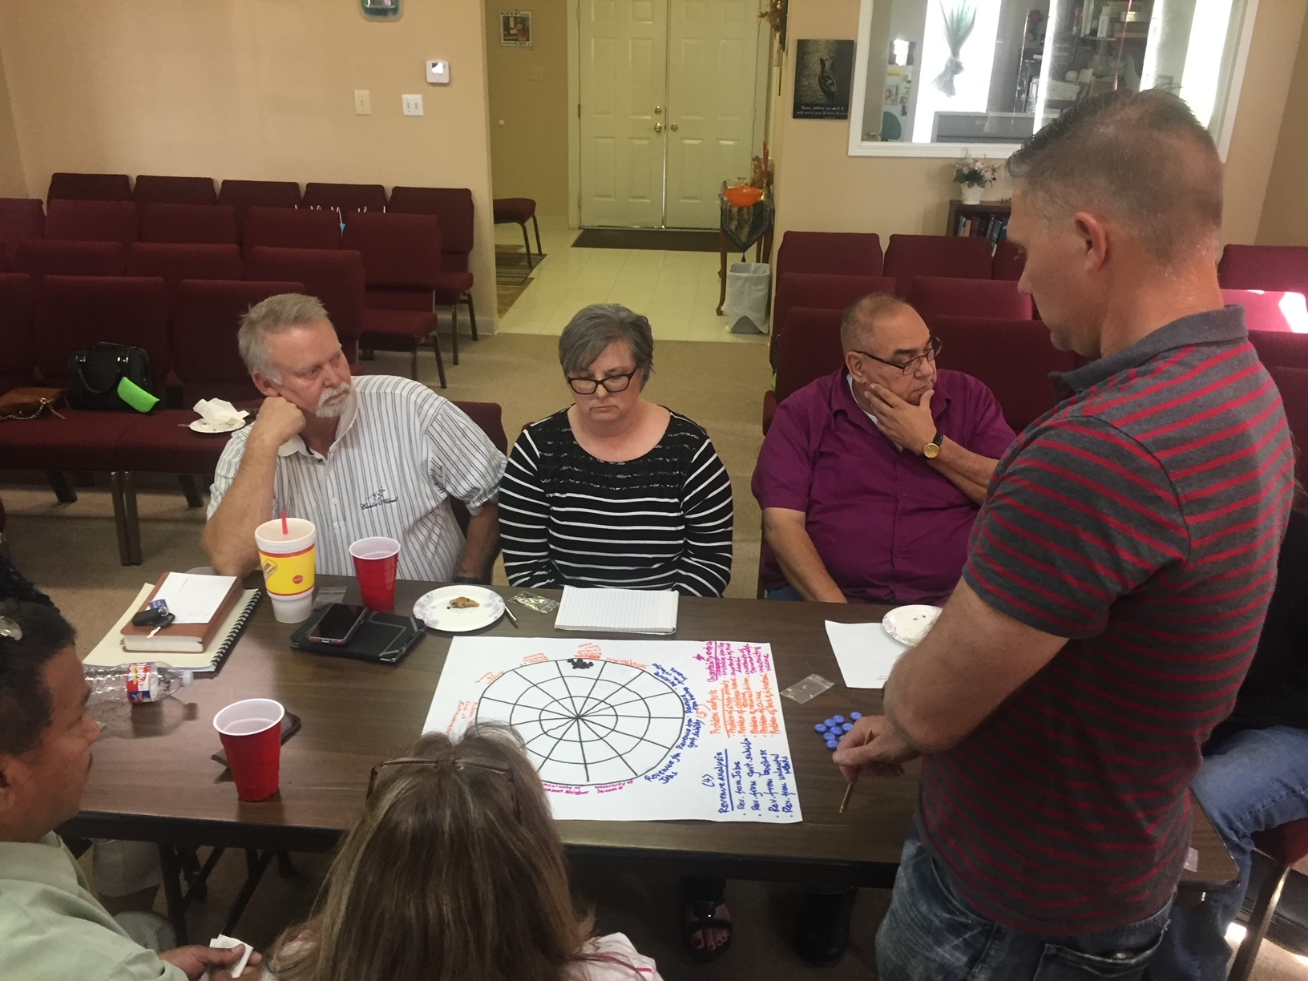
The Scientific Method vs Fundamentalism
Then we are open to any charlatan that comes along - religious or political
If we are not able to ask skeptical questions, to interrogate those who tell us that something is true.
Are we searching for what is truth out there or restricting our thoughts only to that which is revealed in an ancient book? Hence unable to move forwards.

Slide 10
REsearch for What?
Theoretical exploration of an issue? E.g.my paper on post-postmodernism
Anthropological analysis of the mazeways of the mind of a culture:
Socio-economic Description of an issue, situation or problem. E.g. Alvins description of microfinance in Kibera. With 10 variables, what are the problems, optimizations. There are no solutions, but many perspectives and potential implementations.
Solution of an unanswered engineering problem. How do we design the eyes of the moon-rover?
Action Research as part of a change process. It doesn’t just describe. It involves action. Testing, validity occurs within the process.
Participatory Research as a democratization of knowledge production in the processes of such change.

Slide 11
What is Action Research? https://youtu.be/8ISl7JKQuxw to 1:18

Slide 12
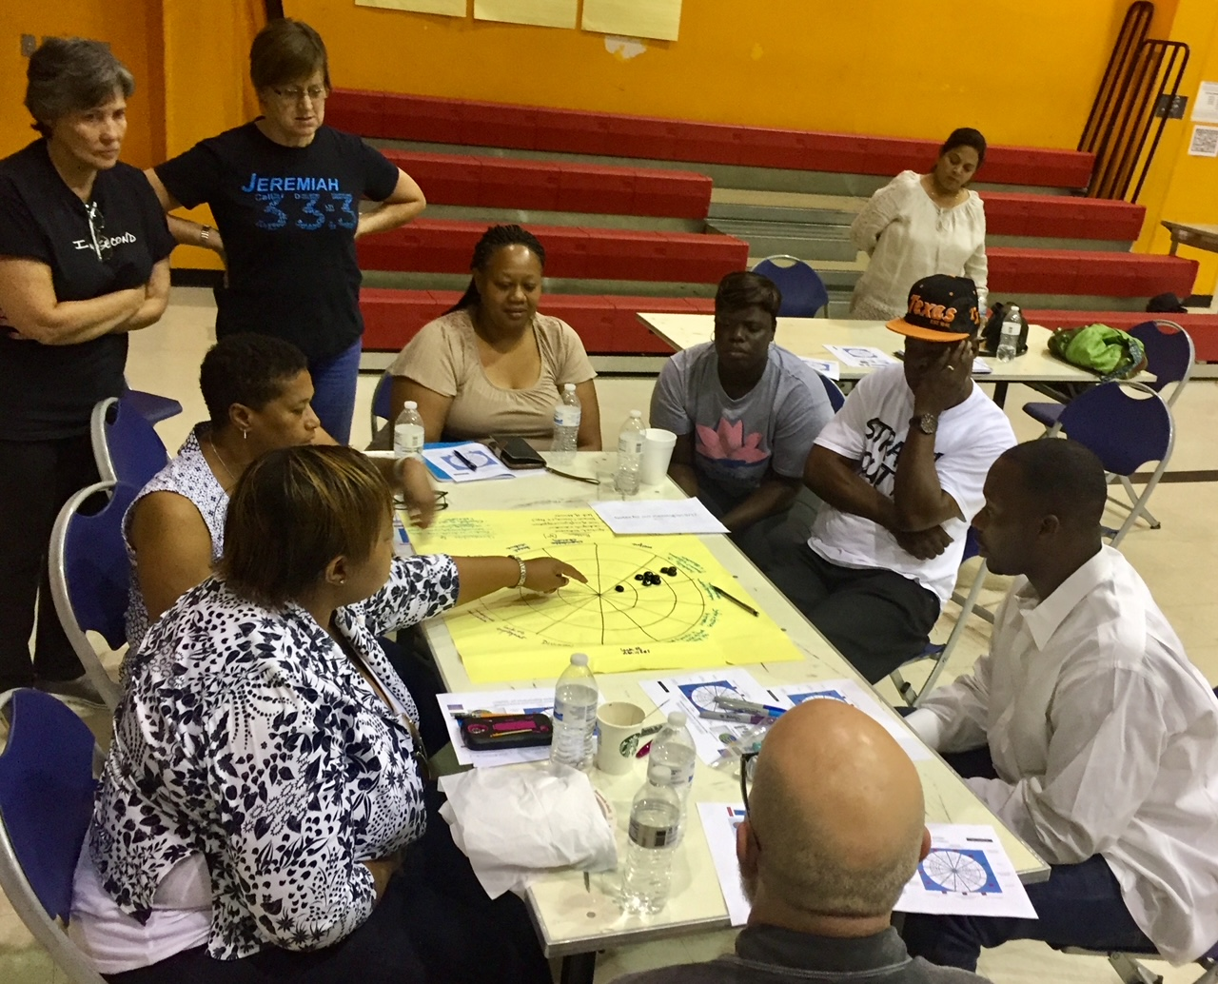
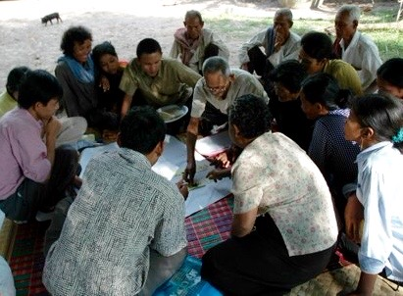
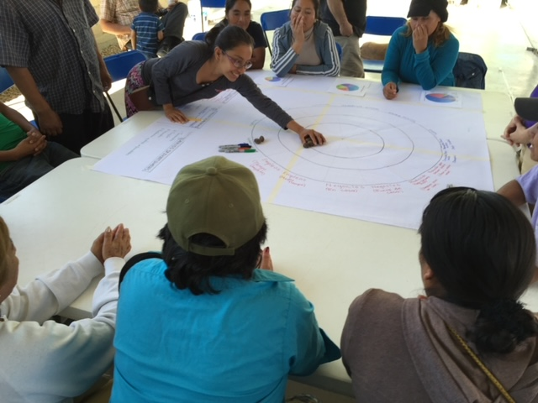
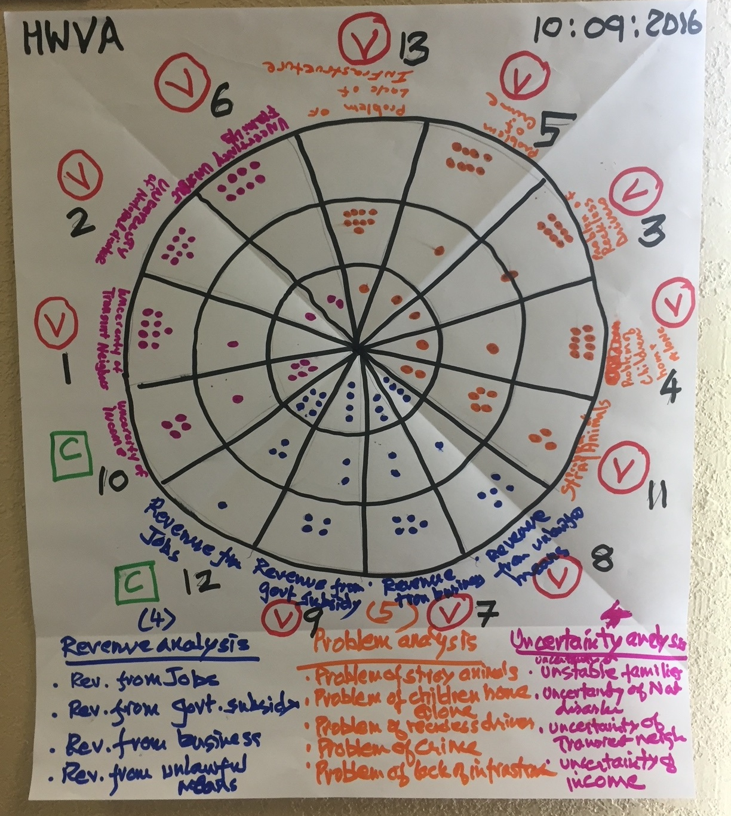
Participatory: Design, Process, Outcomes
Process and Outcomes: Community Action
Research: New Knowledge Owned by the People
Locus: Community/Organization/ Institution/Movement
Communication: Oral and Academic Writiing
Theological Integration: Transformational Conversations/ Consultations

Slide 13
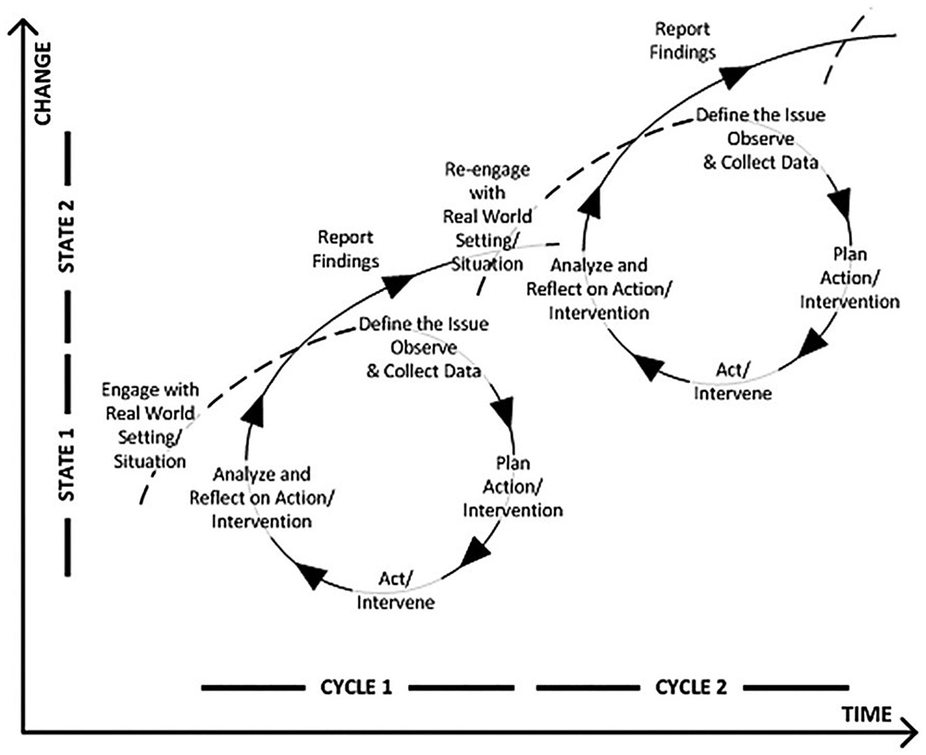
The Hui as PAR
This Photo by Unknown Author is licensed under CC BY

Slide 14
The Double Whammy: Action-reflection at the operational level, New theory at the PhD level

Slide 16
Mode of Participation | Type of Involvement of Local People | Relationship of Outsidersto Local
Coercion | Local people submit to predetermined plans developed by outsiders. | DOING TO
Compliance | Local people are assigned to tasks, often with incentives, by outsiders; the outsiders decide the agenda and direct the process. | DOING FOR
Consultation | Local people’s opinions are asked; local people analyze and decide on a course of action. | DOING FOR
Cooperation | Local people work together with outsiders to determine priorities; responsibility remains with outsiders for directing the process. | DOING WITH
Co-Learning | Local people and outsiders share their knowledge to create appropriate goals and plans, to execute those plans, and to evaluate the results. | DOING WITH
Community Initiated | Local people set their own agenda and mobilize to carry it out without outside initiators and facilitators. | RESPONDING TO
A Participatory Continuum
Adapted from B de Negri, E.Thomas, A. Ilinigumugabo, I. Muvandi, and G. Lewis. Empowering Communities: Participatory Techniques for Community0Based Programme Development. Volume 1(2): Trainer’s Manual (Partipant’s Handbook) (Nairobi, Kenya: Centre for African Family Studies, 1998), 4, as quoted Corbett, S. & Fikkert B., When Helping Hurts: How to Alleviate Poverty without Hurting the Poor…and Yourself, Chicago: Moody Publishers, 2009.

Slide 17
Alternative models for Alvin’s Research
Standard Sociological Descriptive Re-search Approach
Ten problems around savongs groups and outside resources
Sampling: 6 organizations, xx projects from each. Yy people.
Surveys
Statistical analysis of answers
Results to organization leaders
Will they implement recommendations?
What would an anthropological approach be?
What is the site?
What would paarticiaptn observation look like?
How would that be backed up with focus groups, economic analyses?
What would be an alternative PAR approach?
Basic Principles?
Who designs process?
What would be the questions they wish to research?
Who owns the results? Will they implement.
Which methods might be part of the process? Anthro, Sociological? Stats analysis of a survey? Field notes? Consultations? Focus groups? Historical studies?
What would the multiple cycles likely be?

Slide 18
Participatory action research
PAR-CT
= PAR infused theology in action
This Photo by Unknown Author is licensed under CC BY-SA

Slide 19
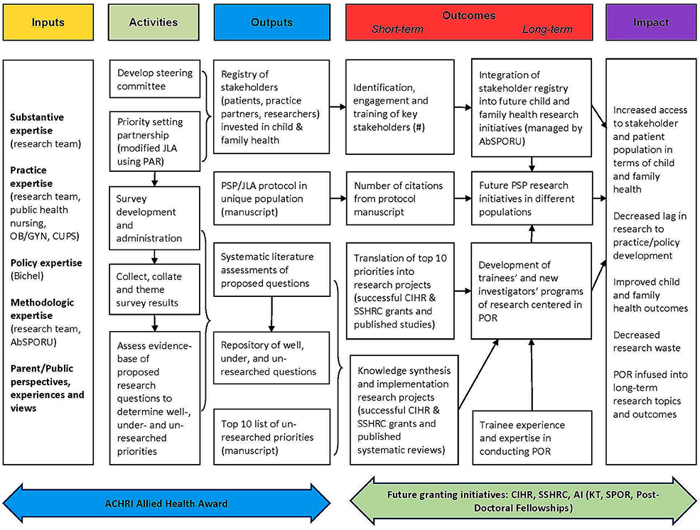
AN Example of large institutional PAR Will you be inside or outside of an Organization? A movement? A community

Slide 20
Evolving Ideas in Evolving Change Processes

