Slide 1
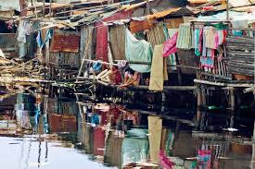
urban Research? Ethics? IRB?
1. Theology of research ethics
2. Central ethical issues
3. Ethics and Bureaucracy
4. STrUCTURE OF AN IRB
5. Three levels of ethics proposal
6.research issues
Dr Viv Grigg
Professor of Urban Leadership
William Carey International University
Updated 2022
MATUL Commission

Slide 2
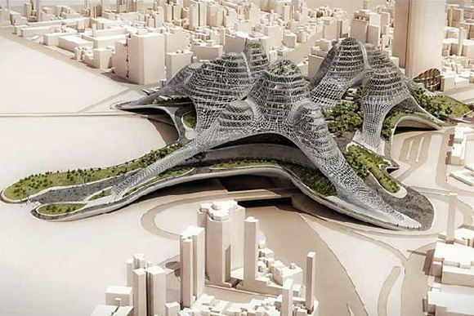
1. TheologY UNDERPINNING Research Ethics 1. theology frames ethics 2. ethics frame cultures 3. cultures are structured through covenants = laws 4. implemented through bureaucracy
Honor God’s hand in IRB procedures, bless him and smile

Slide 3
What are Themes in a Theology of Research?
The search for truth
Discernment: How is truth known – epistemology – each discipline has its own criteria
Collective discernment: Others in the field test your work by those criteria
Where are these principles in the scriptures?

Slide 4
What are Themes in a Theology of Research?
Accountability for ethics
Institutional accountability
Professional accountability
Where are these in the scriptures?

Slide 5
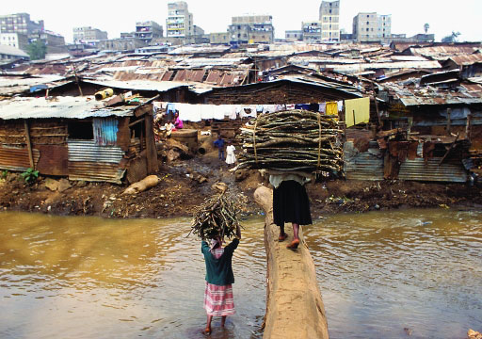
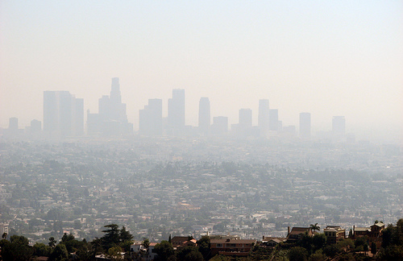
2. What are the underlying ethical questions we face as researchers?
Notes:
The drought and the massive displacement of people in the Horn of Africa, in addition to high food prices and dwindling resources, have created the world's largest humanitarian crisis Some 11 million vulnerable people are now affected.

Slide 6
Ethics in Research involves three basic ethical principles:
Notes:
The drought and the massive displacement of people in the Horn of Africa, in addition to high food prices and dwindling resources, have created the world's largest humanitarian crisis Some 11 million vulnerable people are now affected.

Slide 7
Ethics in Research involves three basic ethical principles:
• Respect for Persons People should be allowed to freely make their own decisions People who cannot make their own decisions (children, mentally ill, etc.) should have protection
Notes:
The drought and the massive displacement of people in the Horn of Africa, in addition to high food prices and dwindling resources, have created the world's largest humanitarian crisis Some 11 million vulnerable people are now affected.

Slide 8
Ethics in Research involves three basic ethical principles: • Kindness: Do not harm. Maximize possible benefits & minimize possible harms
Notes:
The drought and the massive displacement of people in the Horn of Africa, in addition to high food prices and dwindling resources, have created the world's largest humanitarian crisis Some 11 million vulnerable people are now affected.

Slide 9
Ethics in Research involves three basic ethical principles: • Justice: Fairness in distribution of possible benefits and risks
Notes:
The drought and the massive displacement of people in the Horn of Africa, in addition to high food prices and dwindling resources, have created the world's largest humanitarian crisis Some 11 million vulnerable people are now affected.

Slide 10
3. Practical IMPLication of Ethics into bureaucracy 1. Get Informed Consent People involved in research can choose what will or will not happen to them They have enough information about the research, understand it, and willingly agree to participate

Slide 11
Practical IMPLications of Ethics into bureaucracy 2. Assessment of Risk & Benefits The researcher and another group of people on a review board, separately review the research proposal and to see if the possi- ble risks and benefits are responsible and fair

Slide 12
Practical IMPLications of Ethics into bureaucracy 3.Selection of Participants Do not take advantage of vulnerable populations (e.g. minorities, economically disadvantaged, prisoners, men tally ill) (The Belmont Report became a basis for development of these ideas)

Slide 13
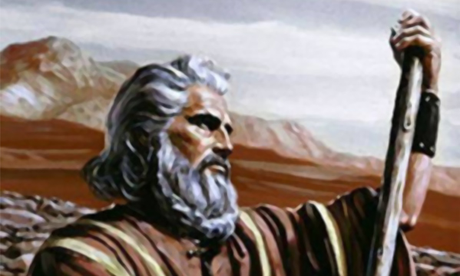
4. STRUCTURE OF an IRB 1. internal (prevents external attacks) 2. independent experienced researchers from multiple disciplines 3. legally astute (within cultural norms) 4. Efficient administrators 5. inspector-types, nitpickers
This Photo by Unknown Author is licensed under CC BY-NC-ND
-(quick
-

Slide 14
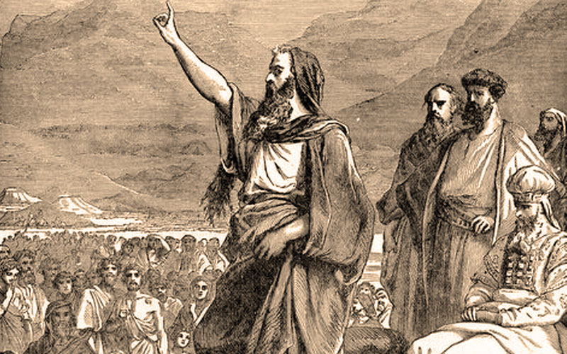
5. Three Levels of ethics application to an IRB 1. EXEMPT APPLICATION 2. Expedited Review 3. Full Ethics Application How Do you Choose?
This Photo by Unknown Author is licensed under CC BY-SA-NC

Slide 15
6. research issues don’t create issues that don’t exist

Slide 16
Oral research issues don’t create issues that don’t exist
Most cultures and the poor rarely sign documents
Legal issues are outside the worldview of non-formal cultures
What needs to go in a script?

Slide 17
Qualitative research and an irb
Psychologists view accountability differently to anthropologists

Slide 18
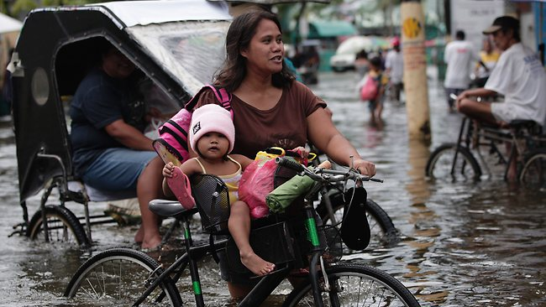
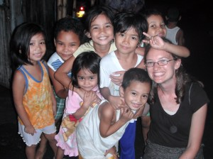
Accountability to the community
To whom do you owe your research results?
Are their names acknowledged?
Who will make the decisions to implement your results?
Who will be impacted?
typical Urban Movement service learning experiences

Slide 19
Ethics of ACTION REsEARCH
the city
The theology
The issue
The outcomes

Slide 20
Transformational Conversation
4.Transformat-ional Conversations
2.Faith Conversations
3.Socio-Economic Conversat-ions
5.New faith-action story
Demonstrated in
Communal Action
Entrance story, solidarity, discontinuity

Slide 21
Financial ethics who is funding this? Who will benefit by publication? How does the community benefit? How does the individual benefit? Budget and cash flow supervision?

Slide 22
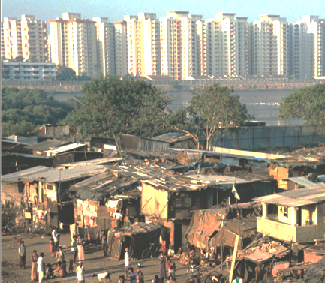
International Research Issues
International Compilation of Human Research Standards at: http://www.hhs.gov/ohrp/international/index.htm
Indian Research Ethics: IEC Report Dec 2002-2004

Slide 23
Tricky questions
What to do with corruption?
At https://www.youtube.com/user/ethicsmodules you will find videos of the following that include both skills with video in research and the ethical issues involved
Introduction to Ethical Image Making
Take a Seat [4:33]
Sensitive Subjects [4:00]
Research with Kids [1:30]
Images of Suffering [1:41]
Cameras and Research: Tokyo Skateboarders: [6 min.]

Slide 24
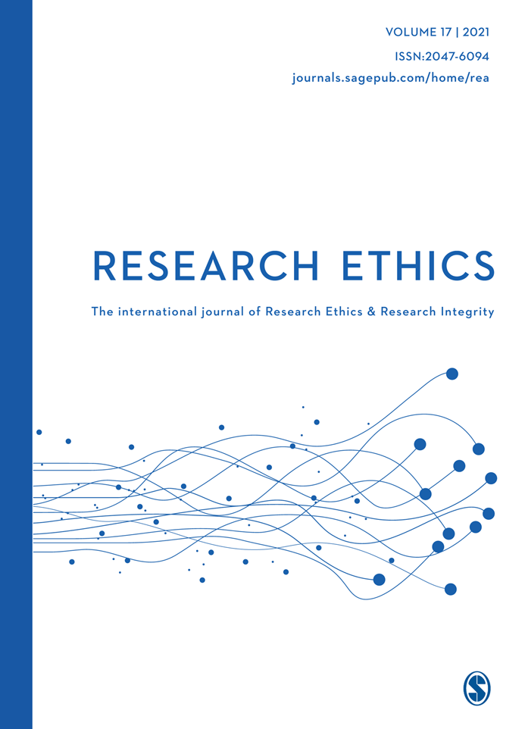
SOME READINGS
American Anthropological Association. Statement on Ethics. www.aaanet.org and at https://www.americananthro.org/ParticipateAndAdvocate/Content.aspx?ItemNumber=1652
Office for Human Research Protections U.S. Department of Health & Human Services. Human Subject Regulations Decision Charts. https://www.hhs.gov/ohrp/regulations-and-policy/decision-charts/index.html#c1
International Compilation of Human Research Standards at: http://www.hhs.gov/ohrp/international/index.htm
Indian Research Ethics: IEC Report Dec 2002-2004
https://www.youtube.com/user/ethicsmodules
Oral Consent. https://campusirb.duke.edu/resources/samples/oral-consent
Research Without Consent: #51 at http://sru.soc.surrey.ac.uk/SRU51.pdf

