Slide 1
Analysis of Urban Conversations
Identifying the themes
In Transformational Conversations
Linking the voices of the poor to the Academe and the Decision-makers

Slide 2
Four Approaches to Disaggregation of Data
Coding
Searching for multiples
What is Missing?
Table-making

Slide 3
Structured Process in Grounded Theory from Strauss and Cobin
Open Coding: disaggregation of the data into units
Axial Coding: recognizing relationships between categories
Selective Coding: the integration of categories to produce a theory

Slide 4
Expansion of Structured Process into Develoment Action Research
Open Coding: disaggregation of the data into units
Axial Coding: recognizing relationships between categories
Selective Coding: the integration of categories to produce a theory
Action-Reflection Research
Specific Implementation Directions

Slide 5
Expansion of Structured Process into Missiological Research using a Transformational Conversations Approach
Open Coding: disaggregation of the data into units
Axial Coding: recognizing relationships between categories
Theological conversation
Urban conversations
Selective Coding: the integration of categories to produce a theory
Urban
Theological
or integration of these
Missiological or Development Action-Reflection = Structural/Organizational expressions of the theological responses
Specific Implementation Directions

Slide 6
Communication of Evidence to Support a Truth Claim
Graphical Communication
Not like this black page
Clearly Presented Graphically

Slide 7
Data People
Clarity of Truth
Data accuracy
Data breadth
Data validity
People’ perspective
Peoples words
People give life

Slide 8
Data People
Integrated Theory
Data accuracy
Data breadth
Data validity
Theological Conversation
City Conversation
Transformational Conversation
People’ perspective
Peoples words
People give life

Slide 9
A picture is worth a thousand words
Graphcal People

Slide 10
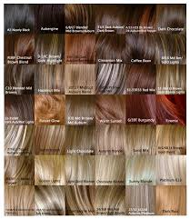
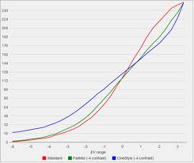
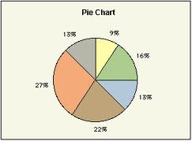
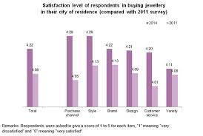
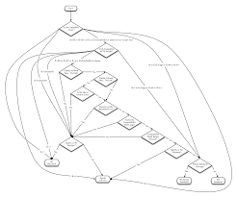
Chart options

Slide 11
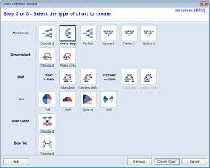
Which to Use?
Charts
Table? exact, objective
Bar Chart? Less exact (though you can add figures), but quicker to grasp.
Line Graph? Makes progressions easy to see

Slide 12
Visual or Verbal Audiences?
Theologians don’t read graphs. Economists do.

Slide 13
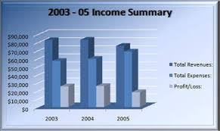
Introduce your data with a sentence that explicitly tells the reader what to see in it. Then give the chart, table or graph a title that names the purpose. Fig 1: blah , blah, blah
Chart
Don’t forget ethics
Organize table, chart or graph in a way that anticipates how the reader will use it (not how you see it but how they can see it). Highlight the data that is most relevant.
n.b. avoid three dimensional graphs and icons like 3 ½ fooball players stacked on each other. They confuse.
KISS

Slide 14
Make your point. Keep it simple.
Lay out your data with style
aaa
bbb
ccc
Graphics make it simple

Slide 15
What about the missing data?
Data analysis
Avoid having any!!
The problem is towards the end your realize you have missed the point, and are examining the wrong issues.
What to do? Add it in? Extrapolate and hope you are right? Explain why it is missing? State it as an issue for future research.?
Most decisions are made with less than 50% of the needed evidence.

Slide 16
Signposting: Logical Connectors in Writing style
Think of all the linkages between the pieces.
Chapter: How does this chapter connect to the last? To the main theme?
Connecting Phrases
This paragraph is about…
Based on this…
The implications are…
Structure of a paragraph
First line says what you will say.
Next sentences expand on this
Last line logically connects to the next the next paragraph

Slide 17
Thick Truth
Beyond analysis to multiple layers of meaning

Slide 18
Discussion What are the major patterns in the observations? What are the relationships, trends, and generalizations in the results? What are the exceptions to these patterns? What are the likely causes underlying these? Is there agreement or disagreement with previous work Interpret your results in terms of the background you laid out in the introduction Consider all the interpretations, then reject some. But be even handed Avoid preaching and bandwagons. Let the data speak the truth. But be passionate. What do you know now that you didn’t know when you began? Include the evidence for the line of reasoning What is the significance of the results? Should we care? Is there material that doesn’t contribute to the above. Then shift it elsewhere. Or delete it. (put it in a file for publishing next year)
e

Slide 19
Core Theme
Sub b
Sub c
Sub a
Which will be your primary focus?

Slide 20
Plot Theme Passion
Can those reading capture the ebb and flow of the drama your are parading?
You are not writing for nerds but for activists
Sub b
Sub c
Sub a
Objective
Yet
Pasionate

Slide 21
Structural Theological Conversations
How do your themes result in action proposals?
In action research, you are not writing for nerds but for activists
Action 1
Action c
Sub-action a
Beyond the individuals, what are the structural engagements in the conversation
Structural Voice
Theology is spoken through Structures
Never give up

Slide 22
References View: “I Have Some Interview Data. What Next?”http://www.youtube.com/watch?v=em3dRhwQEAA [9 min.] Ryan & Bernard, “Techniques to Identify Themes”http://www.engin.umich.edu/teaching/crltengin/engineering-education-research-resources/ryan-and-bernard-techniques-to-identify-themes.pdf Booth, Wayne C., Gregory Colomb, Joseph Williams. 2012. The Craft of Research. 3rd edn. University of Chicago. Gray, David. 2014. Doing Research in the Real World, 3rd edn. Sage Publications. pp. 611-614. Grigg, Viv. 2009. Transformational Conversations in Spirit of Christ and the Postmodern City, Emeth Press, ch. 2.

