Slide 1
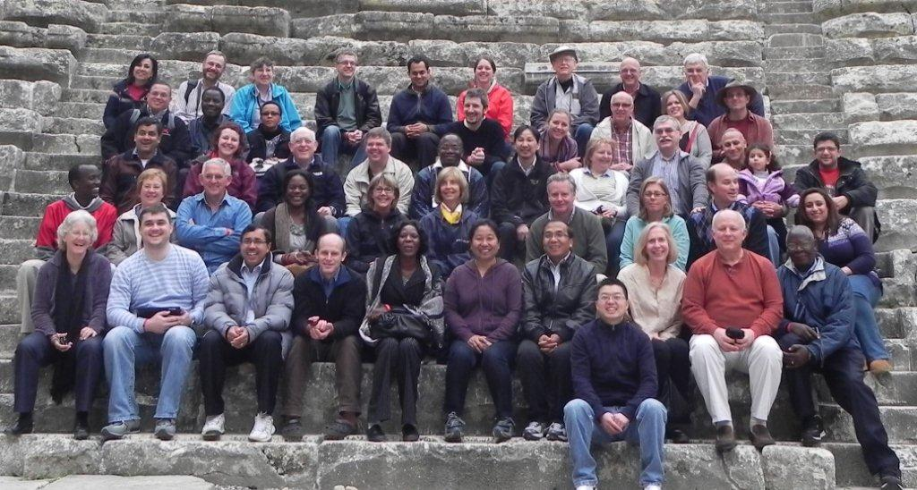
DAI MA Program
October 2012

Slide 3
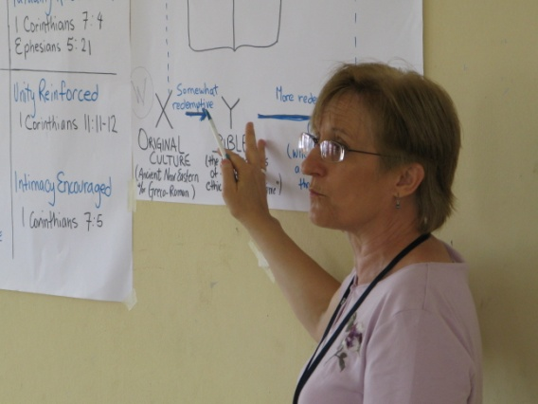
Development Associates International
Our mission is to develop the integrity and effectiveness of Christian leaders worldwide so that the Church can fulfill its role in extending the Kingdom of God.
Offices in the USA, Australia, Belgium, India, Ivory Coast, Russia, the Middle East, Nigeria, South Africa, Nepal, Togo, DRC, UK, Indonesia and Uganda.
We target leaders with the least access to spiritual, human and practical resources with activities in:
Educating
Mentoring
Consulting
Connecting

Slide 4
MA Program Purpose
To provide a high quality, faith-based MA degree in Organizational Leadership in partnership with Christian institutions of higher education in the majority world. Our purpose is accomplished when Christian leaders are transformed and both demonstrate and mentor servant leadership in their contexts as a result of completing the MA program.

Slide 5
Some History: How We Started
First Cohort met in 2004
Partnerships formed with
Allhabad Agricultural Institute & Deemed University: Bombay (9) and Delhi (30)
Methodist University of Katanga: Mulungwishi, DRC (21)
Uganda Christian University (20)
80 students enrolled

Slide 6
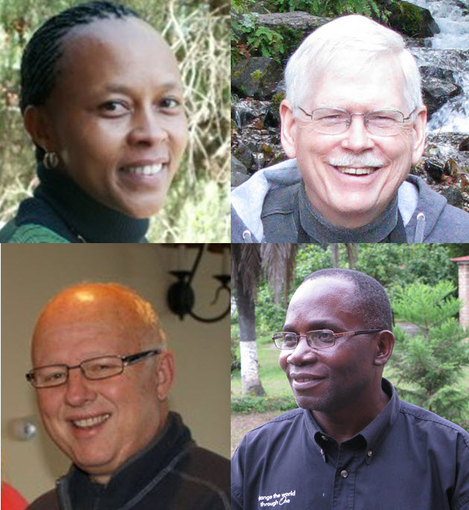
Quick Profile of Program (Mid-2012)
Currently:
4 full time devoted to managing of the MA Program
16 Coordinators (each approximately 1/3 to 1/2 time)
900 students in 35 cohorts in 15 countries meeting twice yearly
112 facilitators from 17 countries
Managing 14 currently developed courses In English and 13 in French
9 Cohorts completing in 2012; 15 new Cohorts in 2013
Christine Mutua
David Fraser
Harold Overstreet
Jean-Marie Nknoge

Slide 7
Quick Profile of Program II
Currently:
Annual budget: US $685,000 ($200,000 additional revenue from student fees and tuition)
Fundraising required: approximately $1000-1100/student per year
Future horizon: plans seek to have 1000 active students in the program by 2015
The MA is currently in a slow growth mode.
About 1300 students enrolled since start

Slide 8
Core Values Emphasized in the MA
Effectiveness: a practice-focused curriculum delivered by facilitators who are able to engage students in a cross-cultural context around leadership issues and models in ways that are transformational.
Integrity: an insistence on high standards in student learning outcomes that reflect the goals of transformation and character formation as well as the development of high levels of competence in servant leadership.
Humility: a posture of learning on the part of both student and facilitator, always aware that students bring a great deal of wisdom, experience and insight into the classroom as well as the facilitator

Slide 9
Core Values Emphasized II
The MA program emphasizes:
Partnering: an appreciative collaboration with host educational institutions who we seek to serve and strengthen.
Biblically-based: a curriculum and delivery system that comports well with and, where relevant, refers directly to biblical materials for grounding and illuminating the best practices of Christian leadership in dialog with the best contemporary leadership thought

Slide 10
MA Program Distinctives
Partnership with Christian Higher education institution
“In-service” target group
Cohort design
Blended or hybrid delivery
Leadership/management content
Faith-based, Christ-centered focus
Practical, professional intention
“Action” research as final integrative project
Improvement of performance and character aim (effectiveness and integrity)

Slide 11
MA Program
Bi-annual residency
Six weeks over three years
Five months after residency to complete work
Email major communication net
Most complete degree in three and a half years
Facilitators from DAI staff, faculty of educational institutions, professionals
Curriculum packaged in modular format with some requiring additional textbook
Final exams at subsequent residency

Slide 12
Major Outcomes
Christian Commitment :
Engendering personal transformation leading to a worldview and understanding that is grounded in biblical foundations for critical reflection, ethical integrity, thoughtful integration and personal spiritual growth and character development of the leader in Christian discipleship and maturity
Community :
Strengthening of a social network of peers and mentors supporting the leader in the task of developing the skill and wisdom essential for navigating the sometimes chaotic and confusing environment of their world

Slide 13
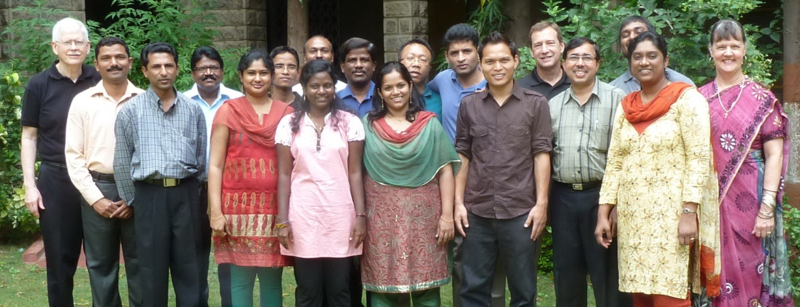
Major Outcomes II
Leadership:
Fostering value-based leadership competencies required for envisioning and leading performance-oriented, learning organizations
Management :
Developing team-oriented managerial competencies that create well-run systems that serve the organizational mission and the well-being of all stakeholders

Slide 14
Major Outcomes III
Professionalism:
Enhancing the professionalism of the leader-manager through greater mission competence, commitment, and vision as well as problem-solving abilities
Relevance:
Providing an interactive forum in which curricular matters are focused on understanding one’s organization and context so as to be able to apply what is learned to one’s current work setting

Slide 15
Overview of Current Status (2012)
70 Classes in 15 countries
35 Cohorts active; 25+ countries represented
Average class size: 19 students
122 faculty from 17 countries
220 graduated from program
195 at Thesis stage (out of 900 active)

Slide 16
Current Partnerships
Uganda Christian University (Uganda)
Methodist University of Katanga (DR Congo)
Bangui Evangelical School of Theology/FATEB (CAR)
SAUL/FATEB (Senegal)
Burundi Light University (Burundi)
ECWA Theological Seminary Igbaja (Nigeria)
Allahabad Agricultural Institute and Deemed University (India)
Nepal Ebenezer Bible College (Kathmandu, Nepal)
Evangelical Theological Seminary (Cairo, Egypt)
African Christian University/Nairobi Evangelical Graduate School of Theology (Kenya)
Faculté de Théologie Protestante (Congo, Brazzaville)
Lanka Bible College (Sri Lanka)
Myanmar Evangelical Graduate School of Theology
Evangelical University of Chad
The Papua New Guinea University of Technology (UNITECH)

Slide 17
Future Profile
By 2015—
1000 of the right students annually
Being well facilitated by using adult learning techniques in a blended delivery system
Using a contextually appropriate, transformative curriculum
In partnership with like-minded educational institutions that have a high degree of ownership
Being well served by DAI staff and systems

Slide 18
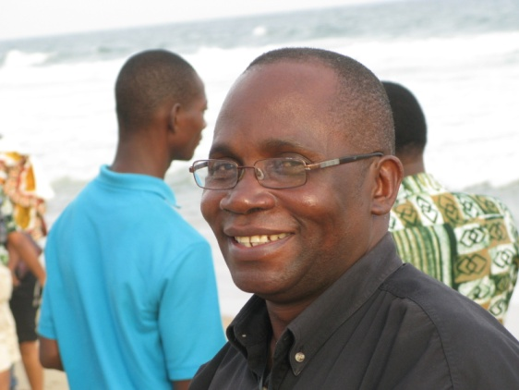
Operations
MA Team
David A. Fraser, MA Director
Jean-Marie Nkonge, Director for Francophone programs
Harold Overstreet, Administrative Director
Christine Mutua, Director, MA English Programs, East Africa
Cohort Coordinators
Egypt: Fouad Shaker Sadek - Chad: Kirya
Uganda: Jairus Mutebe - DRC: Andrew Sompwe
Kenya: Jean Mwangi - Burundi: Emile Ndoricimpa
Nigeria: Raheem Ibitoye - Senegal: Donald Sylla Mbaye
Central African Republic: Enoch Tompte-tom
Brazzaville: Dr. Mamy Raharimanantosoa
India: Jaya Biju
N.E. India: Raaj Pradhan
Nepal: Narayan Khadka
Sri Lanka: Chrishan Jayasuriya
Myanmar: Ngul Cin Thang
Papua New Guinea: Gary Salli

Slide 19
Curriculum Sequence
TERM | South Asia Sequence
#1 | Teaching & Learning For Impact | Leadership
#2 | Strategic Thinking | Women In Leadership and Ministry
#3 | Spiritual Formation | Integrity & Finance
#4 | Ethics For Living & Leading | Conflict Mgt. & Resolution
#5 | Introduction to Research Methods I | *Elective (from 4 choices)
#6 | Introduction to Research Methods II | Culture, Ethnicity & Diversity
 Electives
Development and Social Change;
Partnerships;
Fundraising;
Mentoring

Slide 20
Curriculum Year 1
Year 1 Residency 1
Year 1 Residency 2
Course 1 LEAD 511
Leadership – Making Human Strength productive
Course 2 LEAD 522
Teaching and Learning for Impact
Course 3 LEAD 521
Strategic Thinking
Course 4 LEAD 532
Women in Leadership and Ministry

Slide 21
Curriculum Year 2
Year 2 Residency 3
Year 2 Residency 4
Course 5 LEAD 541
Spiritual Formation
Course 6 LEAD 531
Integrity and Finance
Course 7 LEAD 652 Ethics for Living and Leading
Course 8 LEAD 542 Conflict Management and Resolution

Slide 22
Curriculum Year 3
Year 3 Residency 5
Year 3 Residency 6
Course 9 LEAD 533
Research Methodology I
ELECTIVE
Course 11 Research Methodology II
Course 12 LEAD 662
Culture, Ethnicity and Diversity
Courses 10: Choose one
of the following four (electives):
LEAD 651: Development
and Social Change
LEAD 523: Mentoring
LEAD 653: Fundraising
LEAD 512: Partnerships

Slide 23
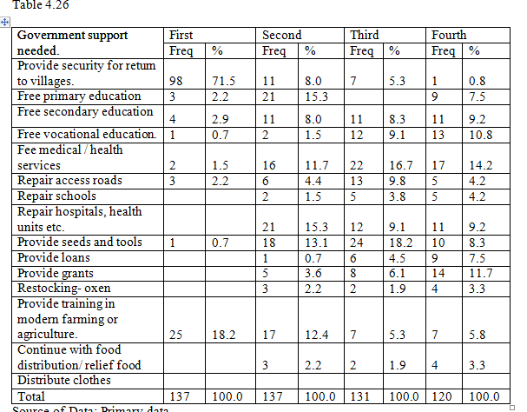
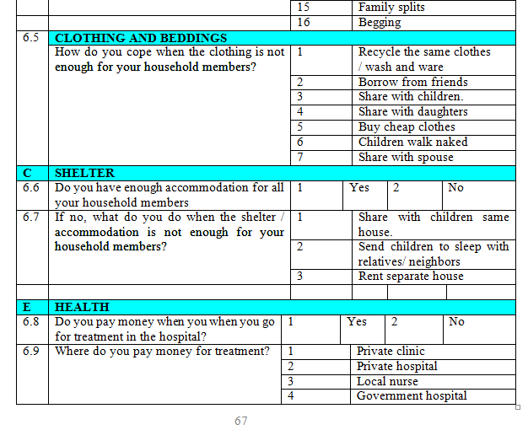
Final Field Project Thesis
Action Research:
Practical Issue in work or ministry
Develop a central research question to gain knowledge of that issue
Use three methods: Survey, Interview, Focus Groups
Produce a final research paper of about 12,000-15,000 words
Approval Process for each Research project
Supervisors read the drafts and approve the final paper

Slide 24
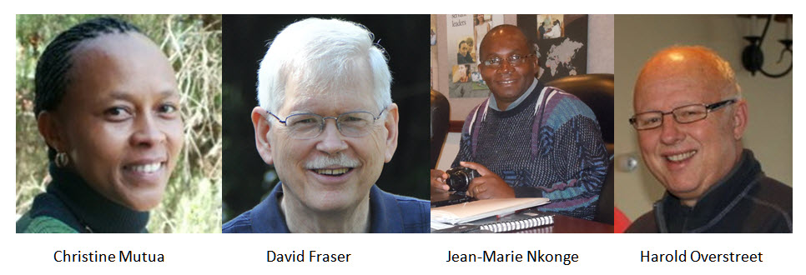
The MA TEAM
Questions?

