Slide 1
Faculty Orientation
DAI 2012

Slide 2
Part 1 – Academic Issues

Slide 3
Program Structure
12 courses over 6 semesters in 3 years
2 semesters per year – Jan-April and Aug-October zones of time, normally
2 courses per semester
Blended Learning Approach (classroom and distance)
‘Classic’ distance education, modularized, textbooks, small learning groups and Email interactions with facilitator
Slow introduction of appropriate technology

Slide 4
Course
The course is prepared for you
For some this is good news
Others are used to teach their own material
You have to get your mind around another person’s thinking and design

Slide 5
Materials – you get
Orientation Documents at Orientation
Additional Resource Book (if required)
Access to Wiki for teaching resources:
Course book and available work books
Sample Syllabus
Sample Examination(s)
Sample Handouts
Discussion with other facilitators

Slide 6
Course Preparation
Study Module Workbook and Units
Read Textbook
Get familiar with translation (French..)
Other reading and study as needed
Contact Harold Overstreet (hoverstreet@daintl.org) if something is unclear or incorrect and if necessary we will connect you with the course author

Slide 7
Residency
Format
Personnel
Cohort coordinator
MCD, DAI-USA staff, Ed Partner representative
Schedule
Sample Residency Schedule
Handouts you have to prepare for students
Syllabus with expectations and key information
Assignment Sheet

Slide 8
Residency II
Objectives of Residency
Build cohort community and cohesion
Develop a personal relationship with students
Build trust with the facilitator
Learn the capabilities of the students
Communicate expectations and requirements of the course
Introduction to the course and its materials
Model the expectations by doing some of the work in residency assignment(s)
Cover critical material that needs face-to-face interaction and clarification

Slide 9
Follow Up
Semester lasts for max. 18 weeks after residency (week 2 usually travel back home) [Exception: Spiritual Formation]
Acknowledge emails within 48 hrs
Mark assignments & give feedback (no grades in case of India)
Remind students who are late or silent (local DAI office/cohort coordinator can assist)

Slide 10
Finish Well
Submit one or two sets of exam papers to DAI office (see sample exam for details- more are available from the US office)
Submit assignment grades to local and US office before final exam
Give feedback to DAI (about your experience)
General questions to David Fraser

Slide 11
Grading
Grade final exam
See sample marking sheet
Weight of internal to external
Differs from country to country
Comparison of grades in US-UK-Africa..
See Grading Systems Sheet

Slide 12
Rationale for British System
Different Premise
A level = Einstein in Physics…. With Albert at 100%
An A indicates very high mastery of the subject matter (which only very few show). So a 75% A means excellent work AND you still have a lot to learn!
The numerical range reflects this (India example)
75 - 100 | A | First division with honors
60-74.9 | B | First division
50-59.9 | C | Second division
41-49.9 | D
40 & below | E | Failure

Slide 13
Additional Information
Student List
In the event of a problem with a student:
Communicate with the cohort coordinator and with Harold, David, Jean-Marie or Christine
Late work is the clearest and most frequent issue:
This requires some flexibility since “life” happens
But you need to be clear with the students from the beginning what your policy is and the consequences for late work

Slide 14
Timeline
Before your 20+ week involvement in facilitating a course discuss with Harold: Course, Country, Time, CV, Travel, Material, Orientation…
Docs for
Students
Receive
first
homework
Feedback finished
on
homework
Receive
second
homework
Pre-Res.:
Personal
Preparation
Week 1:
Residency
Week 2:
Travel
Home
Week 3:
Unit 1
Week 4:
Unit 2
Week 5:
Unit 3
Week 6:
Unit 4
Week 7:
Catch up
Week 8:
Unit 5
Week 10:
Unit 7
Week 9:
Unit 6
Feedback finished
on
homework
Receive
third
homework
Exams
Questions
to DAI
Feedback finished on
homework &
Final Paper
Final
Grading &
Any late
Assignments
Submit
Final
Grades
Week 11:
Unit 8
Week 12:
Catch up
Week 13:
Unit 9
Week 14:
Unit 10
Week 15:
Unit 11
Week 16:
Unit 12
Week 17:
Unit 13
Week 18:
Catch up
Week 19:
Final
Paper
Week 26-7:
Exam
Grading
Break

Slide 15
Example of Schedule
Week 1. February 29-March 5: Introduction to Module in residency
Week 2. Time off to recover!
Week 3. March 13-19: Unit 1
Week 4. March 20-26: Unit 2
Due by April 2, 2011: Compulsory written assignment #1
Week 5. March 27-April 2: Unit 3
Week 6. April 3-9: Discussion with Learning Group
Week 7. April 10-16: Unit 4
Week 8. April 17-23: NO ASSIGN.—Good Friday, Easter week (Apr 24)
Week 9. April 24-30: Unit 5
Week 10. May 1-7: Unit 6
Week 11. May 8-14 Unit 7
Week 12. May 15-21: Discussion with Learning Group
Week 13. May 22-28: Unit 8
DUE BY June 4: COMPULSORY WRITING ASSIGNMENT #2
Week 14. May 29-June 4: NO READING ASSIGNMENT
Week 15. June 5-11: Unit 9
Week 16. June 12-18: Unit 10
Week 17. June 19-25: Meeting/ Discussion with Learning Group
Week 18: June 26-July 2: Unit 11
Week 19: July 3-9: Unit 12
Week 20: July 10-16: Unit 13
Week 21: July 17-23
DUE BY July 23 : FINAL COMPULSORY WRITING ASSIGNMENT #3
Weeks 22-25: time for students to prepare for final exams.
Final Exam August 22, 2011

Slide 16
Field Research
The summative project is a Field Research thesis
Grows out of the Research Methods course
Professionally oriented
Not library but empirical research
Mini-project in the research course gets these projects started
Finish a 60-80 page thesis plus appendices as the last part of the MA
We need thesis readers/supervisors

Slide 17
Questions?

Slide 18
Part 2 – Administrative Issues

Slide 19
Want to facilitate?
You will have a chance at the end of our time together to sign up
We have a pool of interested faculty and may not be able to place you right away into a residency
Harold Overstreet will contact you in terms of your profile of desired courses and time availability

Slide 20
CV, Diploma and Picture
We will need to have:
a copy of your CV
a copy of your highest Diploma (a copy of your transcript from your highest earned degree will do)
a current photo of you

Slide 21
Contract
Once you agreed to facilitate a course a contract will be send to you
Professor’s role
DAI’s commitment to Professor
W-9 Form (for US Citizens only)
Payment information

Slide 22
Tickets
Book early
Let us know the final cost before final booking for approval
Golden Rule Travel
Myron Miller
Email: Myron@goldenrule.net
Web: http://goldenruletravel.com

Slide 23
Travel Arrangements
Visa & Invitation Letter
Immunization
Communication to partners & DAI office
Local staff or cohort coordinator will pick you up at the airport

Slide 24
Travel Policy
Please read the document carefully

Slide 25
Student Info
Update email addresses during residency
Student photos
We seek to get photos of all students and are working on supplying facilitators with class lists and photos of their students

Slide 26
Country Info
Academic Partner contacts
DAI office contacts
Local coordinator

Slide 27
Grades and more
Where and when to send what?
Final Exam (you may be asked to hand carry back previous exams)
Mail back to country coordinator using DHL, UPS etc (tracking number) in a timely manner
Email DAI US office the tracking number and details
Please do not mark anything on original exam – use extra mark sheet!

Slide 28
Evaluations
Residency evaluation
During last day of residency – hardcopy
Check out sample forms
Post-course evaluation
On the first day of residency following each course, students are asked to fill out an instructor and course evaluation form
Check out sample forms

Slide 29
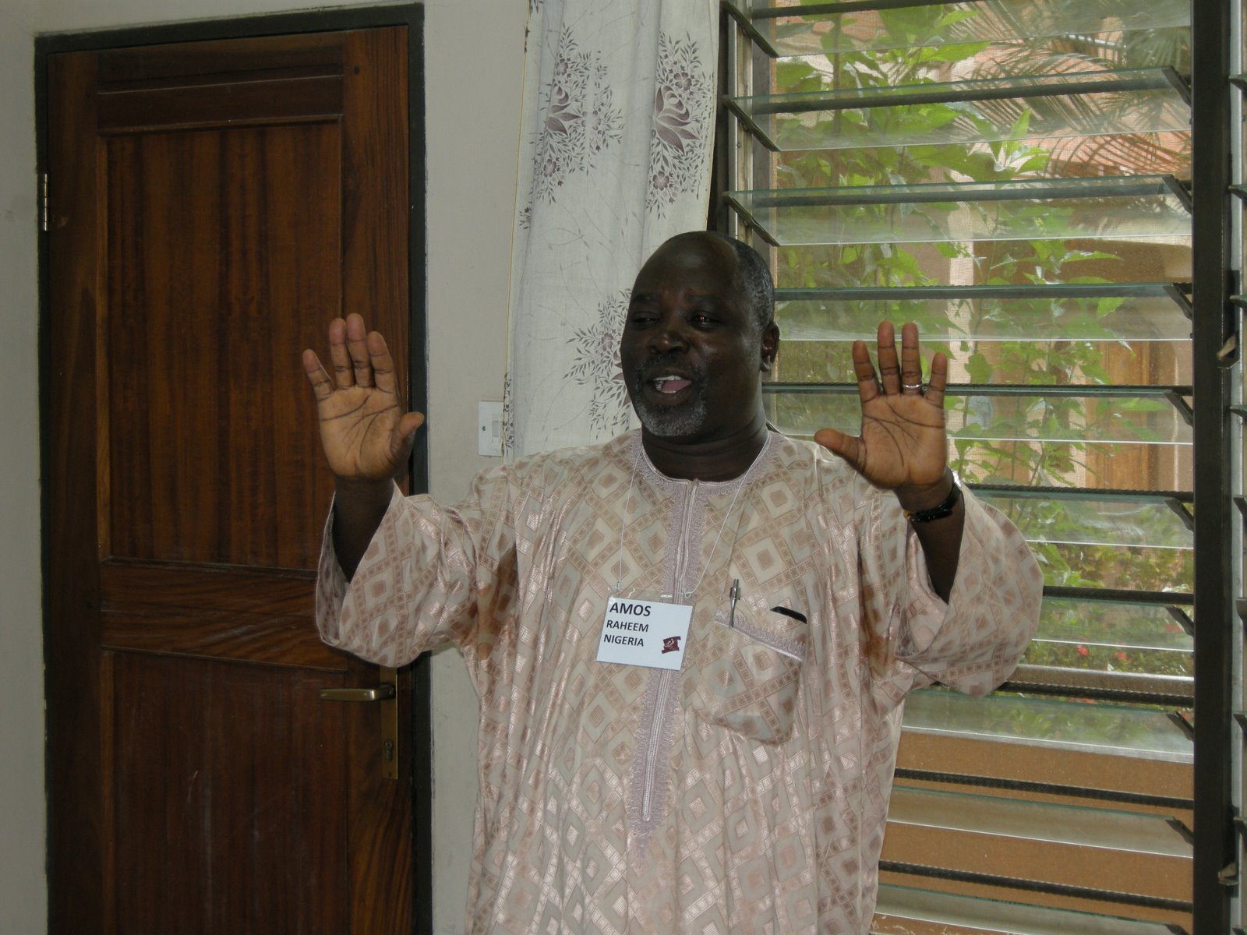
Questions

