Slide 1
MATUL Commission 2013 Uganda Christian University
St Paul’s University and Carlile College

Slide 2
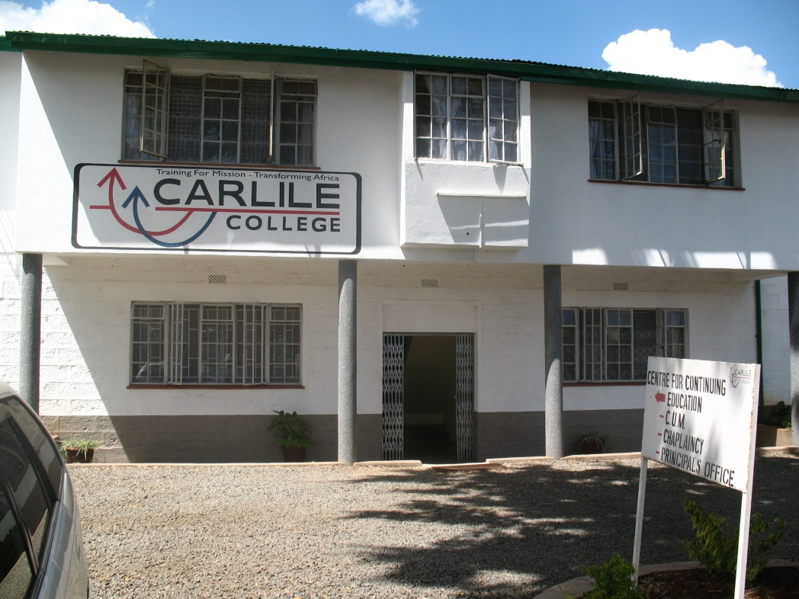
Carlile College and St Paul’s Univerisity

Slide 3
Some of our Students and Faculty

Slide 4
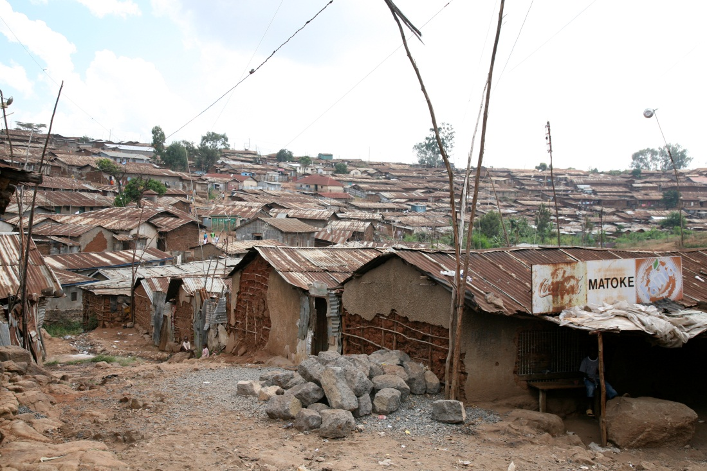
Our Contexts

Slide 5
Student numbers
15 from Kenya
4 from APU
First cohort primarily pastors
Second cohort workers from NGOs and CBOs outnumber pastors

Slide 6
Course Structure
Three taught semesters and one semester for the research project. The final semester is extended so students have up to 10 months to complete.
The course is 60 credits with the research project accounting for 15 credits.

Slide 7
Course structure – Semester One
Course Code Course Title
Urban Theology
MATUL 501 Writings, Reign and Urban Realities
MATUL 504 Urban Reality and Theology
Urban Development
MATUL 502 Theology and Practice of Urban Community Economics
MATUL 503 Gender and Community Transformation
Leadership
MATUL 505 Leadership and Leadership Theory

Slide 8
Course Structure Semester 2
Leadership
MATUL 506 Leading Faith Communities in the city
MATUL 507 Leadership and Conflict Transformation
Urban Development
MATUL 508 Ministry among the Marginalised
MATUL 509: Urban Primary Health Care (Elective) or
MATUL 510 Urban Education Centre Development (Elective) or
MATUL 511 Children at Risk in the City (Elective)
Urban Theology
MATUL 512 Urban Spirituality and Social Transformation

Slide 9
Course Structure Semester 3
Leadership
MATUL 601 Leadership in Urban Movements
MATUL 602 Entrepreneurial and Organisational Leadership
MATUL 603 Managing Change
Urban Development
M ATUL 604 (A) Advocacy: Urban Land and Housing (elective)
or
MATUL 604 (B) Advocacy and urban youth (elective)
Research
MATUL 605 Research Methodology and design

Slide 10
Course Structure Semester 4
Research Project.

Slide 11
What is going well for us?
Beginning to build a good faculty team
Developing good placements for the internships
Improved standards in student work
This year’s intake more financially self sufficient
St Paul’s strengthening IT including use of Turnitin

Slide 12
What has changed for us?
The Course will migrate to the school of Arts and Social Science under a new department of leadership.
Following CHE requirements the leadership dimension to the course has been increased.
CHE requires more electives. New courses have been added.

Slide 13
What has been a challenge for us?
The accreditation process with CHE/CUE
Students putting in a realistic level of reading/study.
Working between two institutions has both strengths and weakness.
Some students struggling with fees – one could not sit exams. US$2000 per year is a challenge in terms of the contexts of the course.
Movement leadership course still seems unclear.

Slide 14
Critical Questions (Academic)
What faculty does the course belong in? Theology/development/leadership/business?
What is the primary discipline within the course?
The breadth of topics gives width but can mean too much is superficial.
Kenyan MAs must have a significant research component. Students may need more input on research methodology and academic writing.

Slide 15
Critical Questions (Financial)
The context of the course focuses on slums/informal settlements but the economies of these communities cannot support typical MA fees. The mixture of NGO’s and mainline churches works but how do we involve AICs, Pentecostals ….. In a sustainable way.

