Slide 1
Sensitive Subjects
Key Paradigm from a video by Heather Settle of Duke University
Presented by Forrest Cammack

Slide 2
Cuba’s Informal Economy
Heather Settle tells a story of going to Cuba to research the impact of econ. crisis on women. Part of the story she wound up with was that prostitution was making a comeback in Cuba because of limited economic options. She did her research with the intention of protecting the identities of those subjects who were in this profession.
As the research progressed, however, she realized that actually most of her subjects were involved in illegal activity (turning to the informal economy for survival), and so she had to adjust her methods to protect the identities of all involved.

Slide 3
Nairobi’s Informal Economy
Nairobi’s slums are in a similar situation to the one in Cuba in that most of its residents are involved in illegal or extra-legal (untaxed) activity. The economic opportunities in the formal economy are very limited, forcing most slum dwellers to work outside of the law.
As we do research, therefore, it will be important to protect the identities of all participants. This is a new thought for me, as Nairobi’s informal economy seems such a commonplace part of life. Even though it is quite benign, it is still illegal, and there is the potential for harm to fall on research participants because of that.

Slide 4
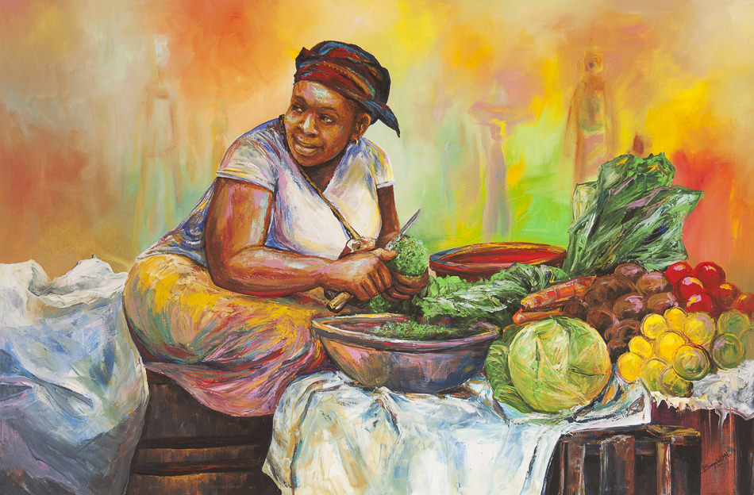
Important Guidelines
Heather mentions the importance of protecting information carefully (locking up computer, putting passwords on it)
Not using details other than those which are absolutely necessary when telling a person’s story.
Painting – “Mama Mwangi aka Mama Mboga” by Bezalel Ngabo from bananahillartgallery.com

